Slide 1
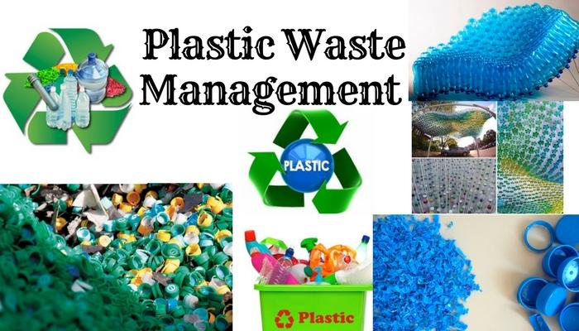

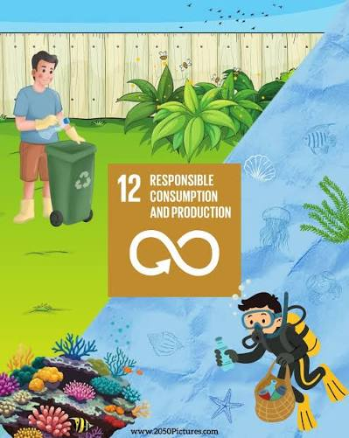
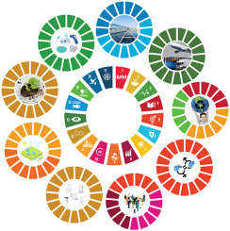
BEYOND THE BIN
-Waste Segregation
and
Plastic Reduction
(SDG 12 &
SDG 14)

Slide 2
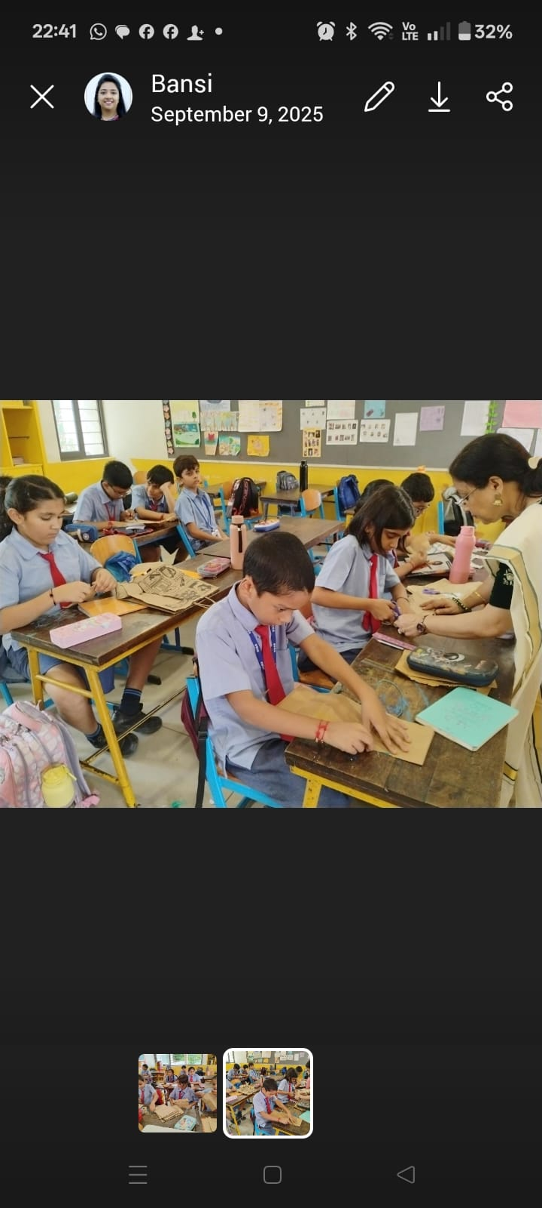
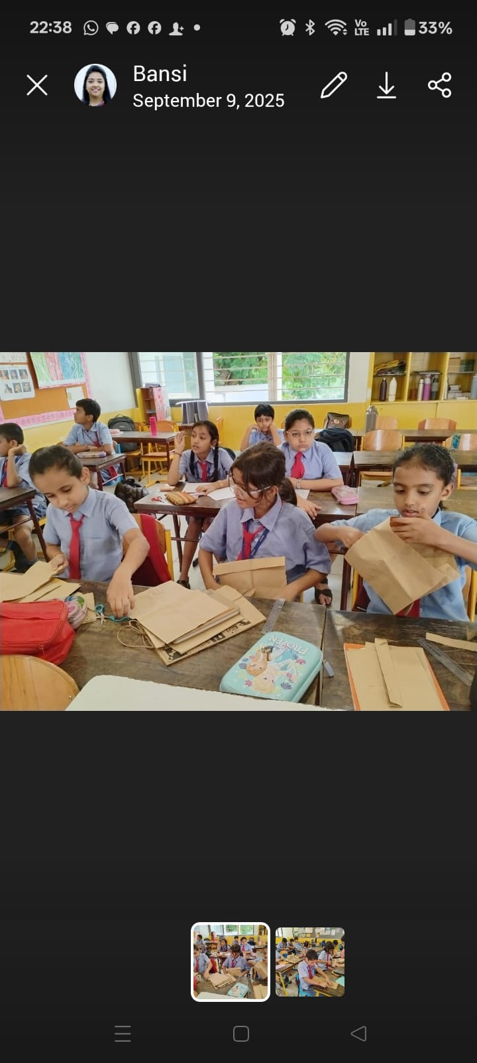
🌱 Project Launch & SDG Awareness
Students participated in a creative activity to give used paper bags a new purpose. Instead of discarding the bags, students carefully cut, folded and reused the paper to make envelopes and small booklets.

Slide 3
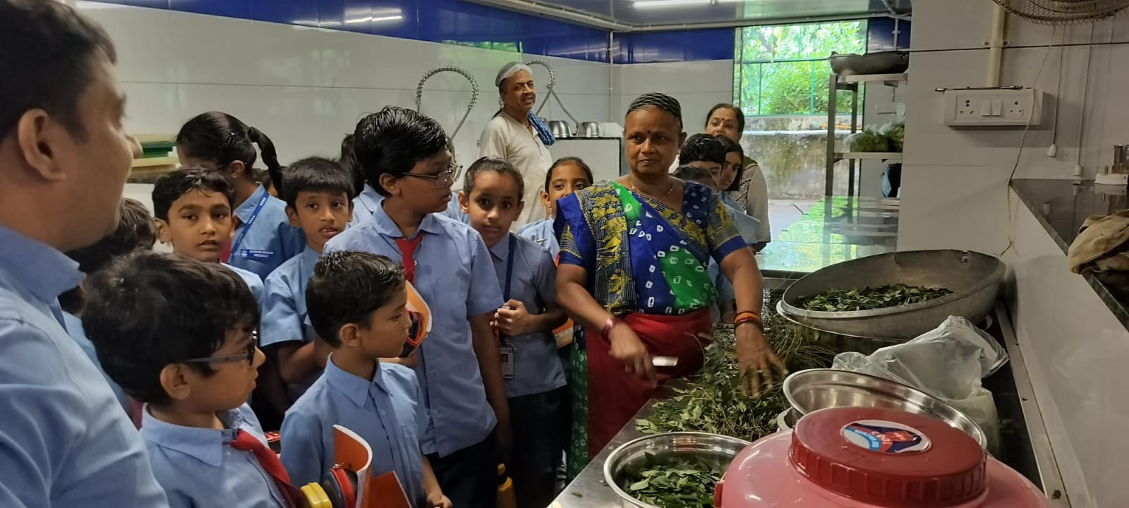
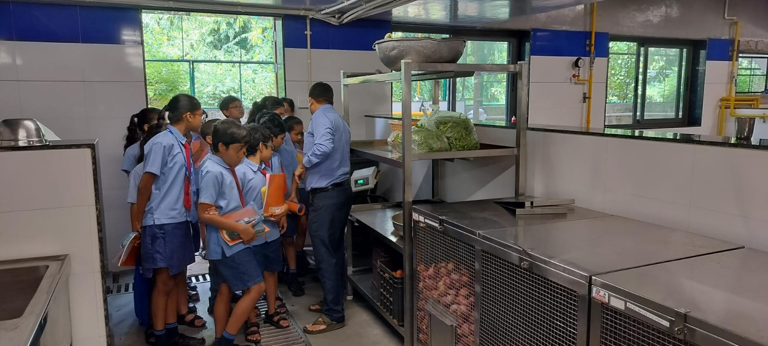
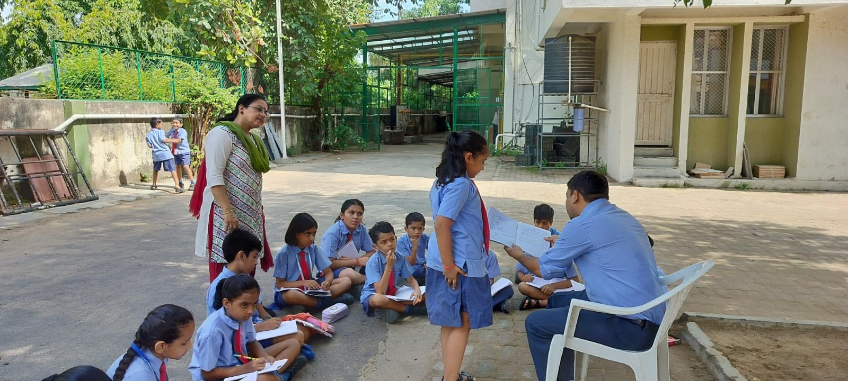
2. 🔍 Waste Audit & Assessment
The students of the SDG Club, Navrachana Higher Secondary School, Sama, interacted with the school canteen manager to understand the canteen’s daily activities and waste management practices. The students discussed various aspects of waste segregation, reduction of food waste, responsible use of resources, and proper disposal of waste. The interaction provided students with valuable insights into how sustainable practices can be incorporated into everyday canteen operations.*Small conversations, meaningful learning, and responsible action! 🌍

Slide 4
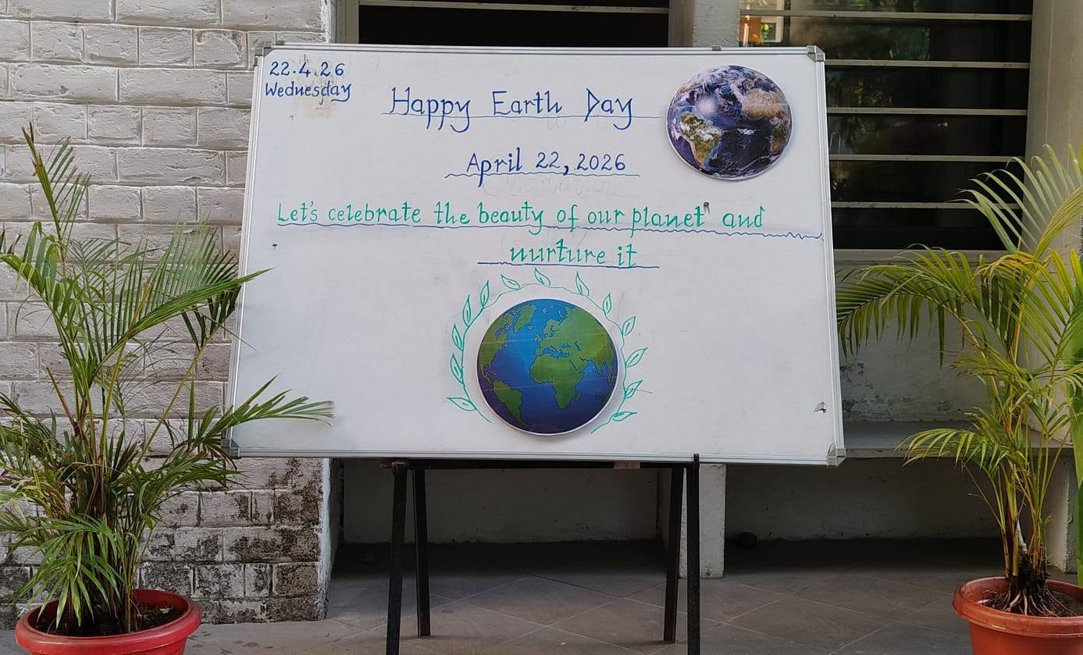
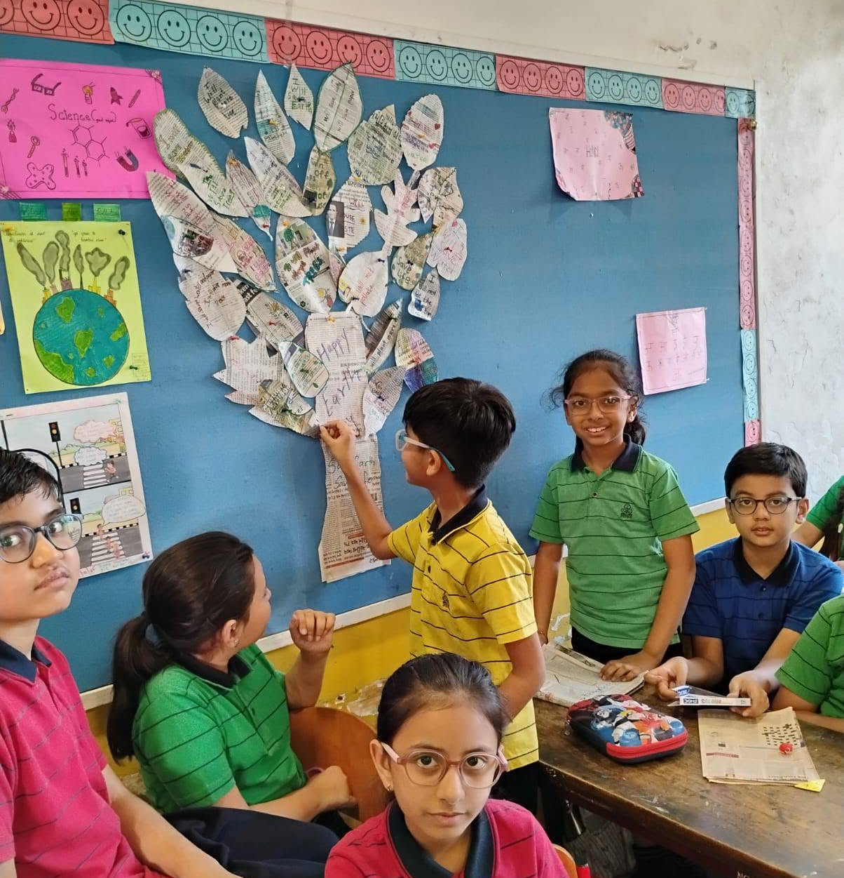
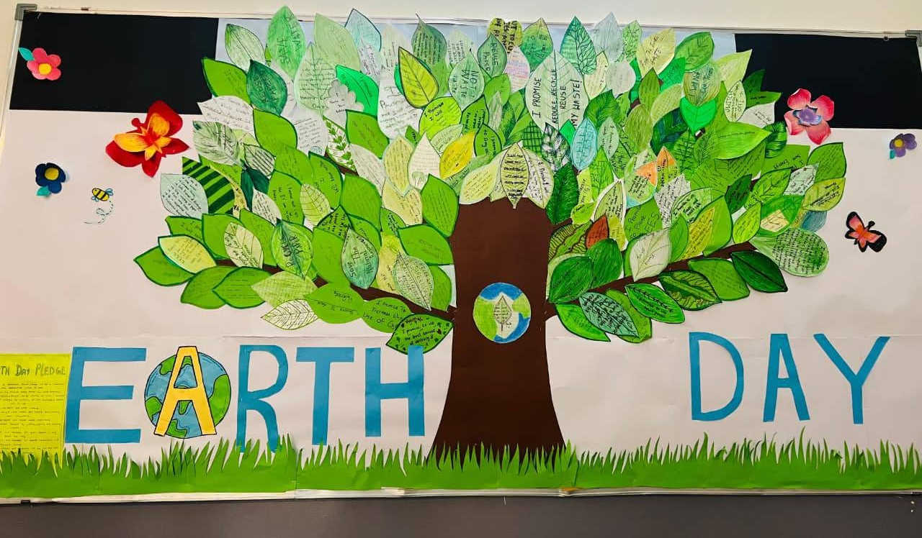
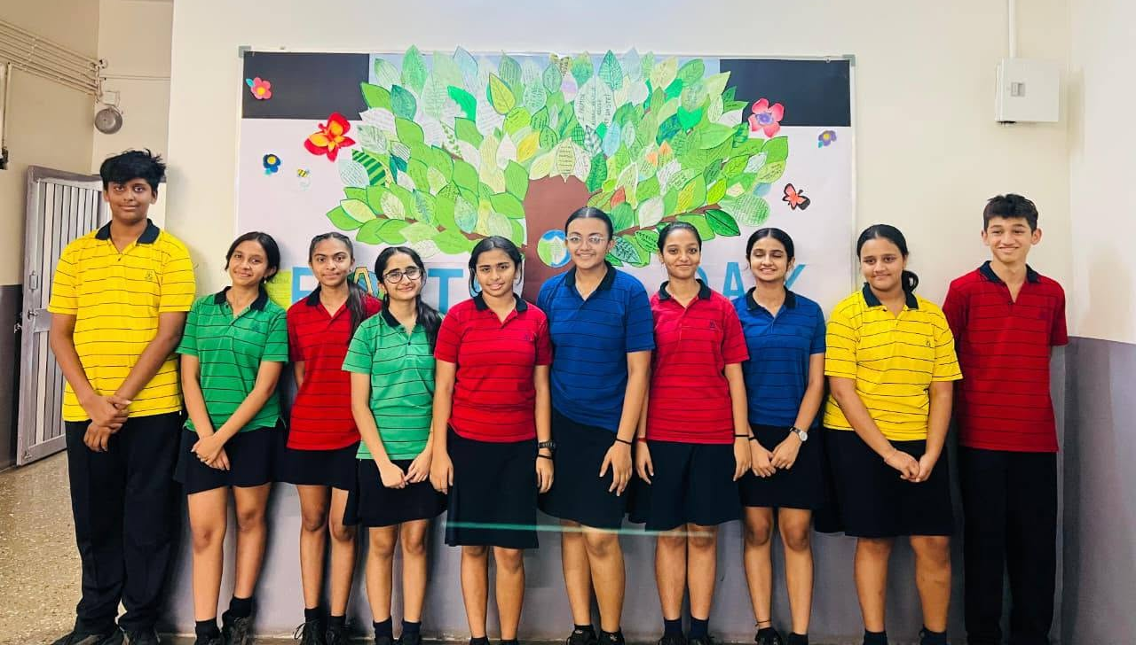
3. Research & Awareness
Assembly conducted for the Awareness of our project and activity of decorating our school bulletin boards was done in each section to spread awareness of plastic reduction and reusing waste in our surroundings.

Slide 5
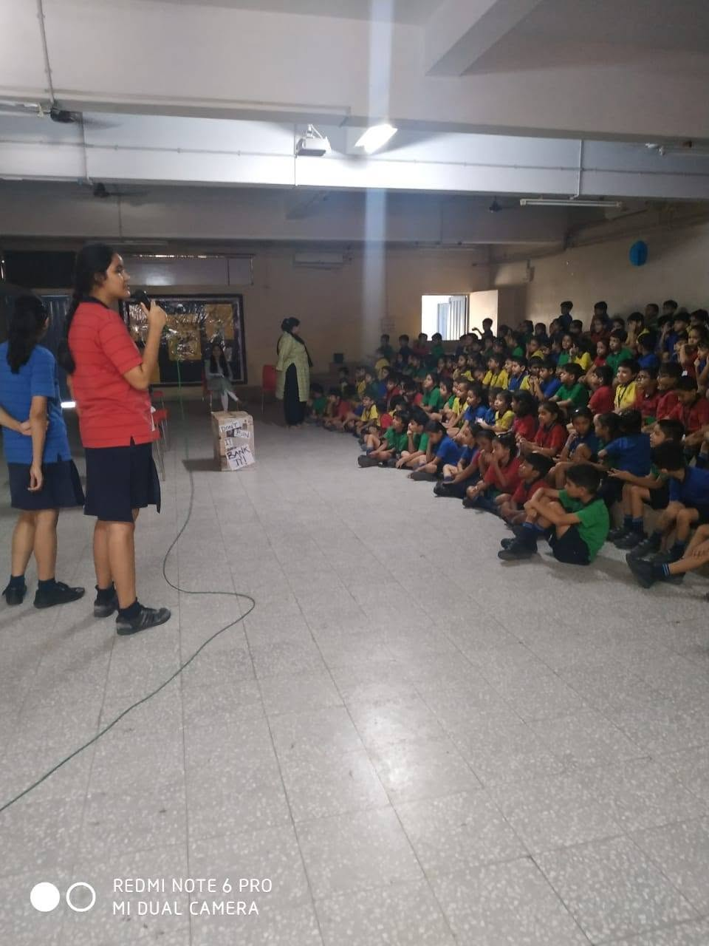
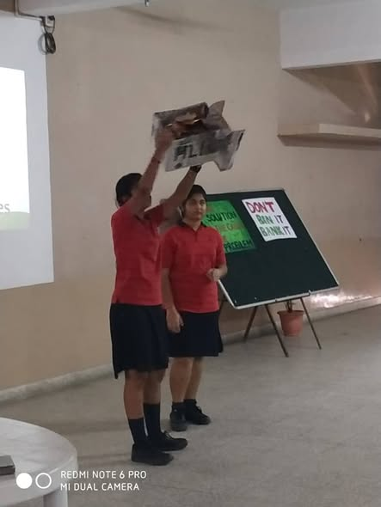
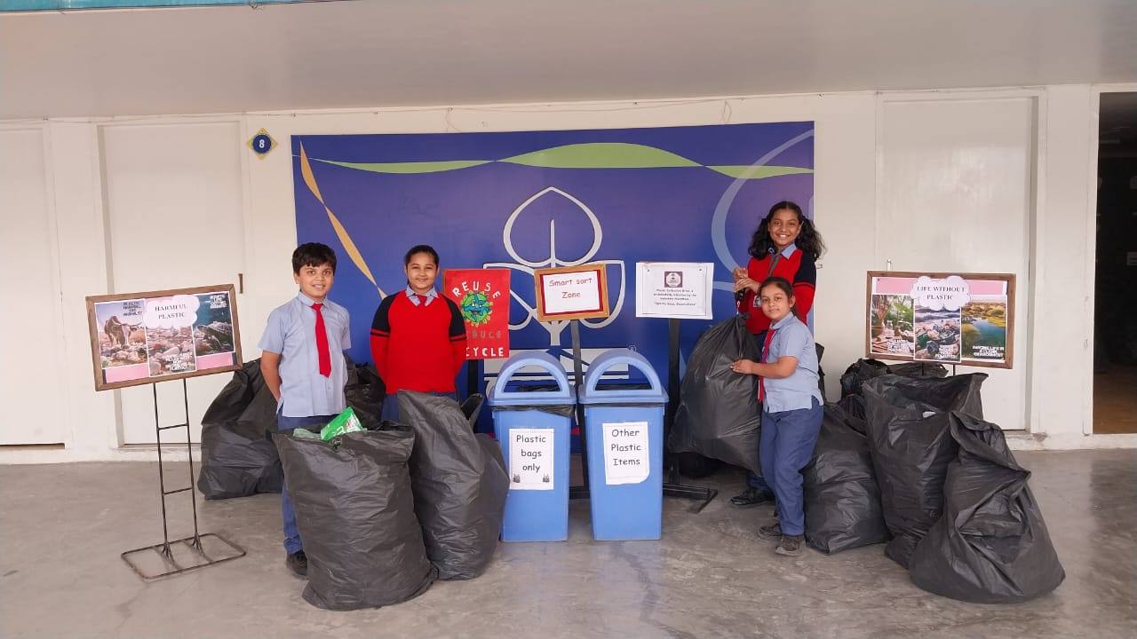
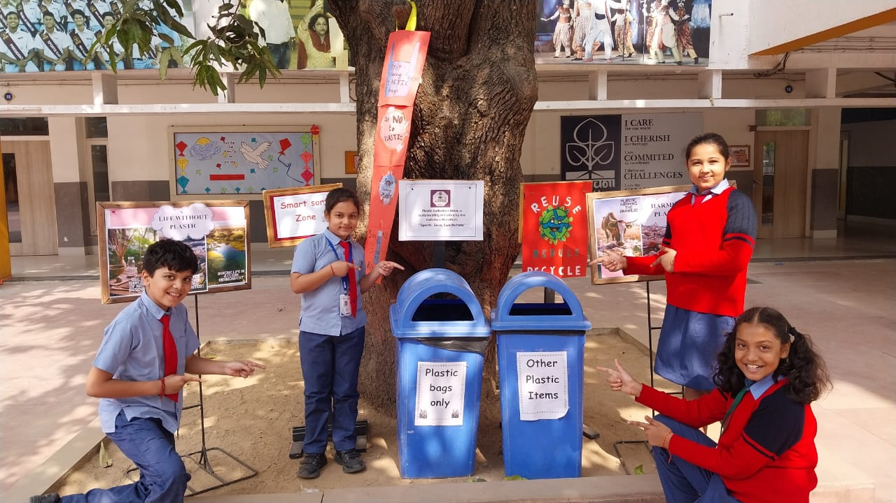
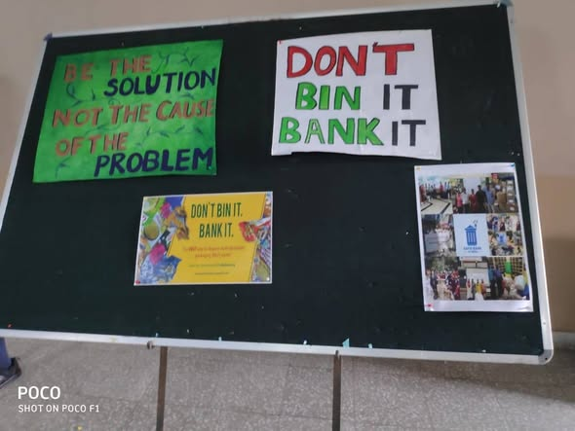
4. 🗑️ Designing the Segregation System
Smart sorting.... Designing sorting system

Slide 6
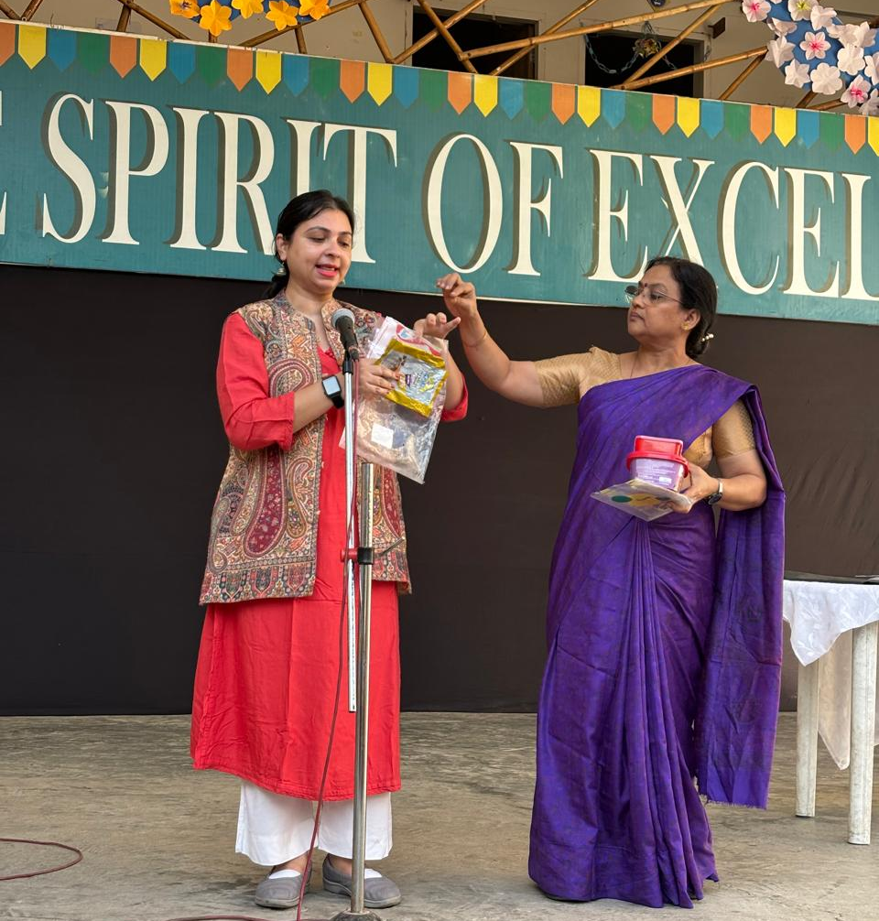
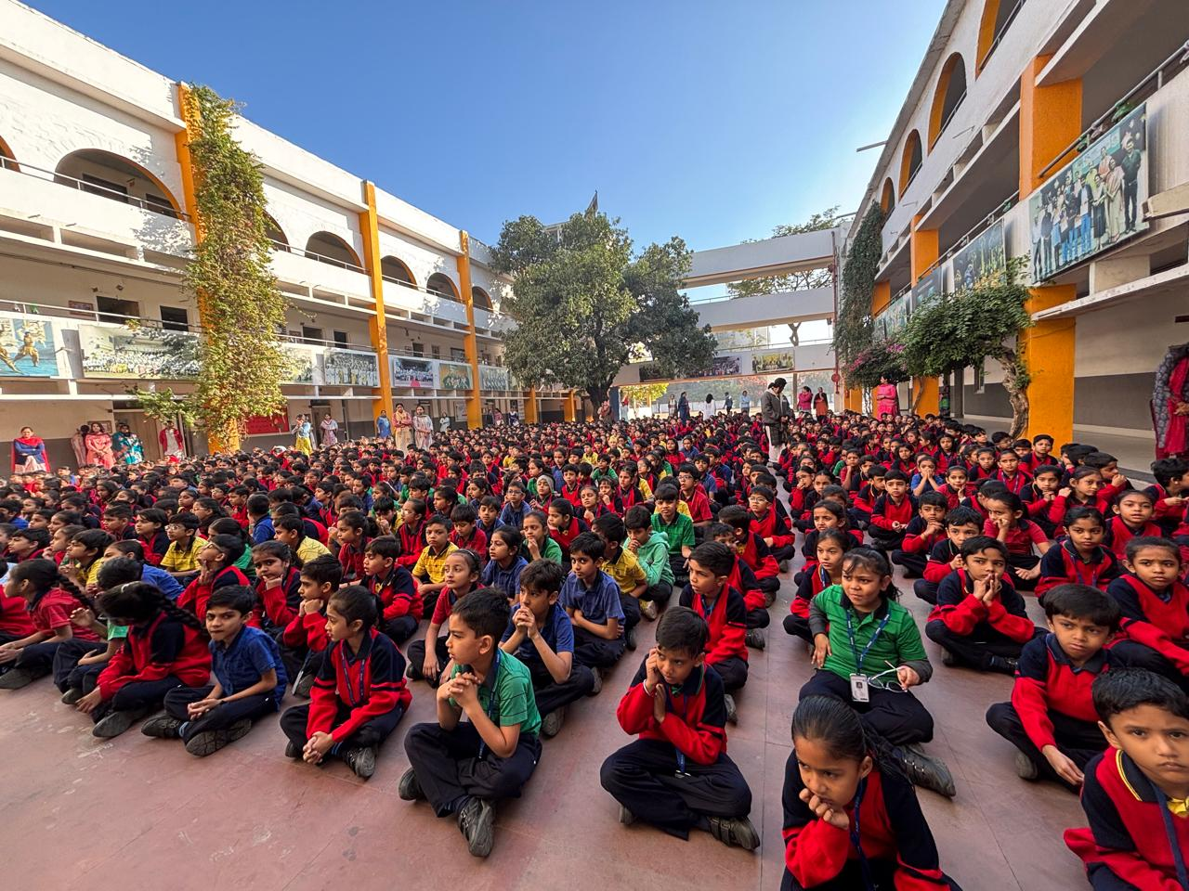
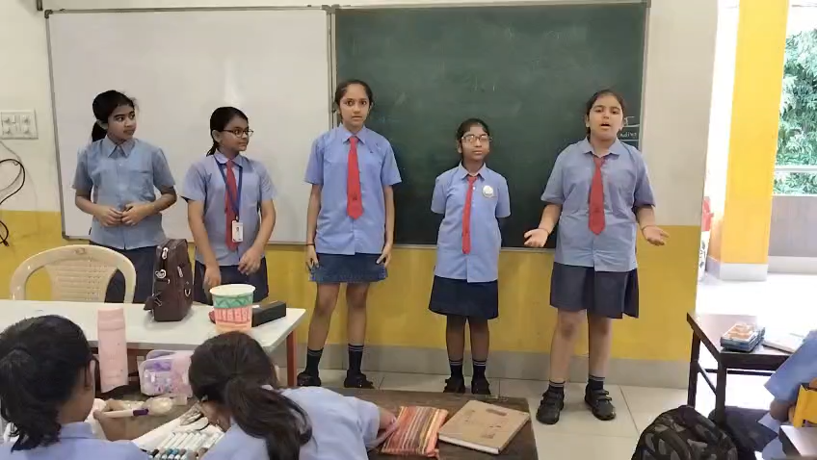
5. 📢 School Awareness Campaign
The Skit on' Every grain of Food has Value 'focused on helping students understand that food involves valuable resources such as water, soil, energy, human effort and money. Students were encouraged to take only as much food as they could finish, avoid unnecessary wastage, and appreciate the effort involved in bringing food from the farm to their plate. The activity concluded with the message: "Value Food, Respect Resources, Reduce Waste!”

Slide 7
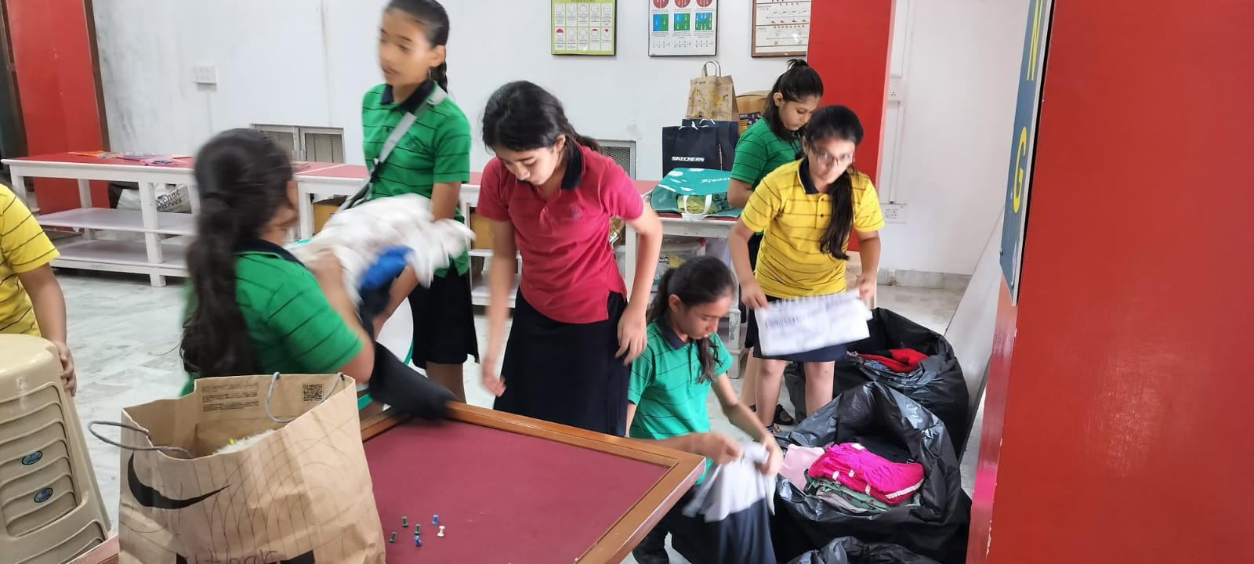
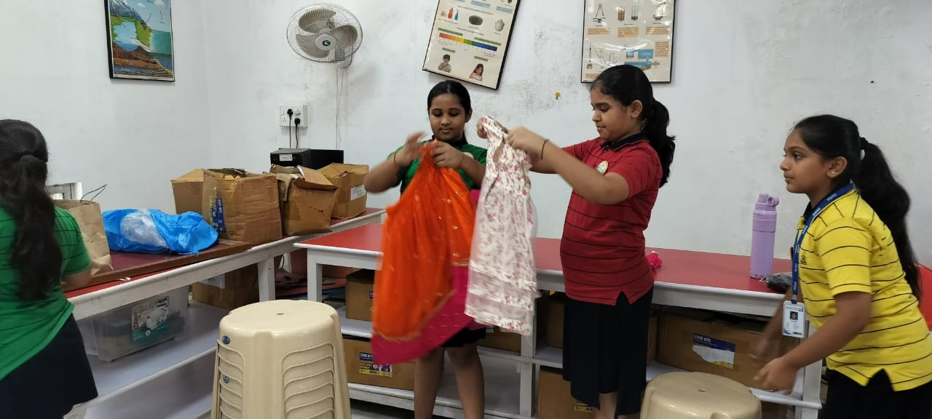
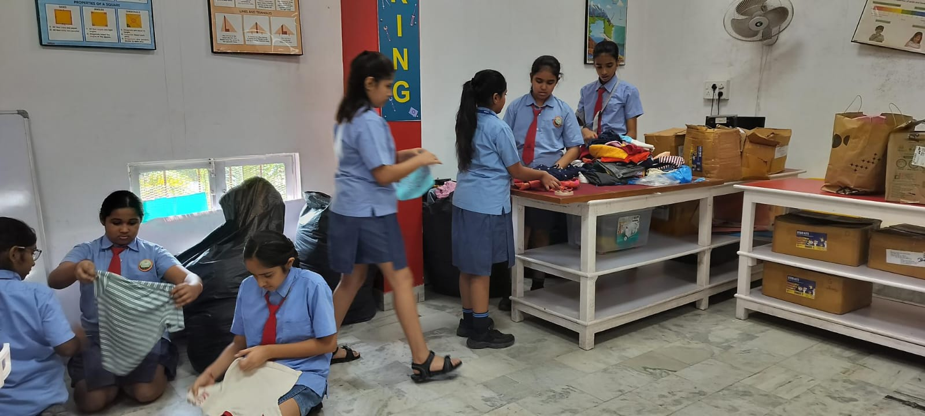
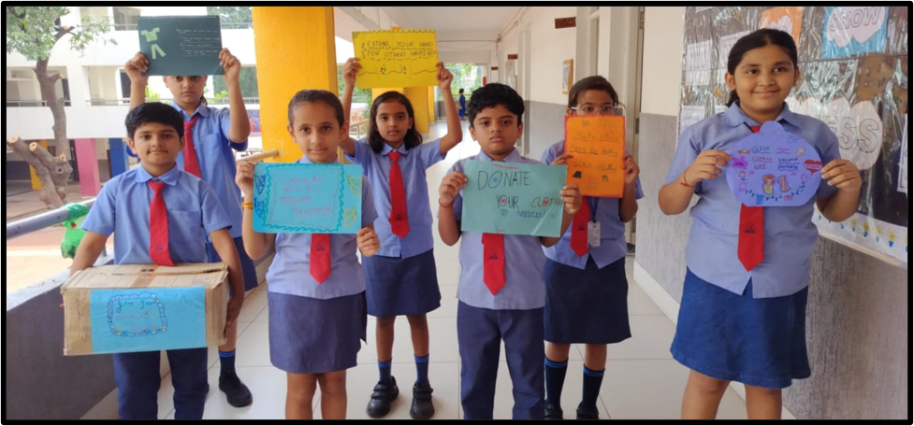
6. Implementation of Segregation
As part of the school’s Waste Management and Sustainable Living initiative, a cloth donation and recycling activity was conducted to sensitise students about the importance of reusing clothes, reducing textile waste, and supporting those in need. The activity concluded with the message: "Donate, Reuse, Recycle—Give Clothes a New Life!”

Slide 8
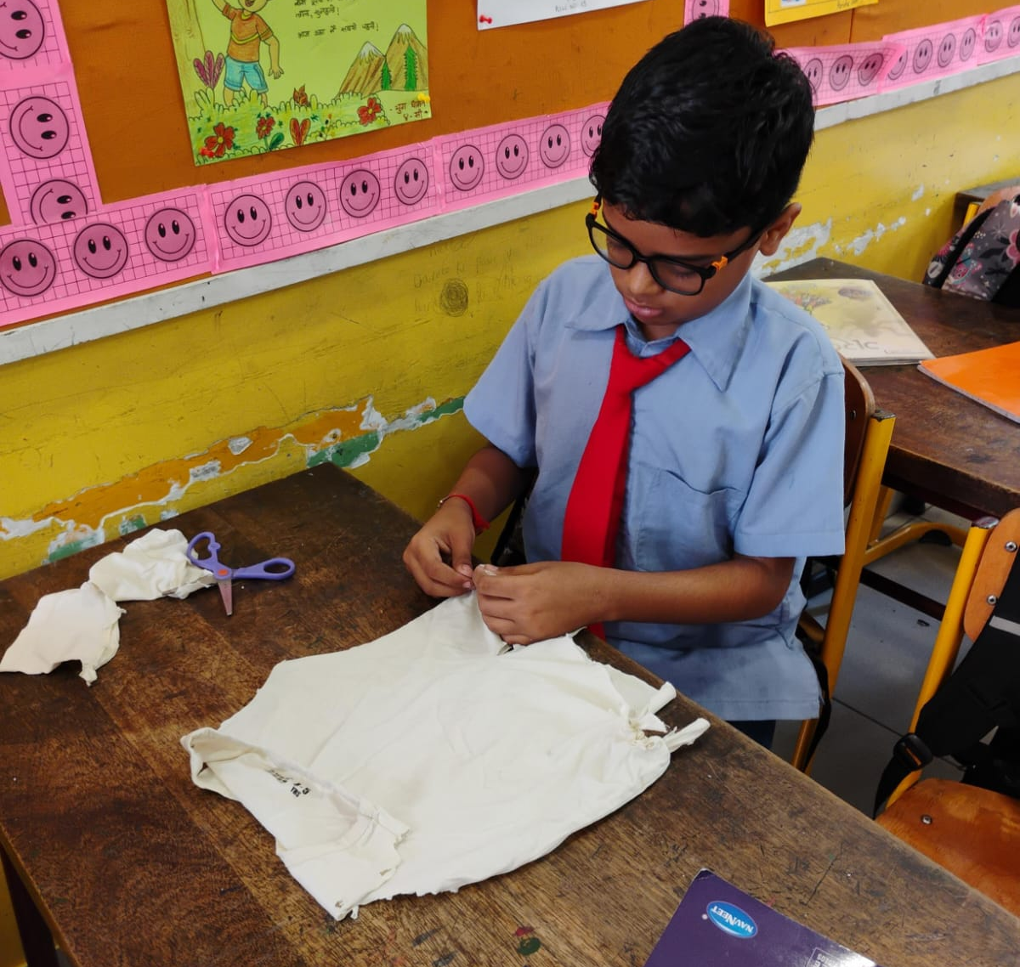
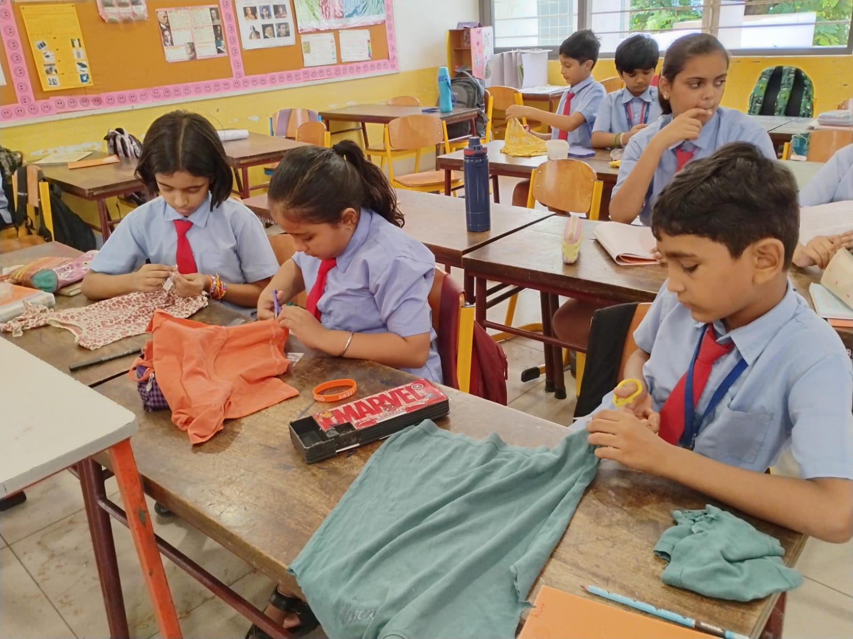
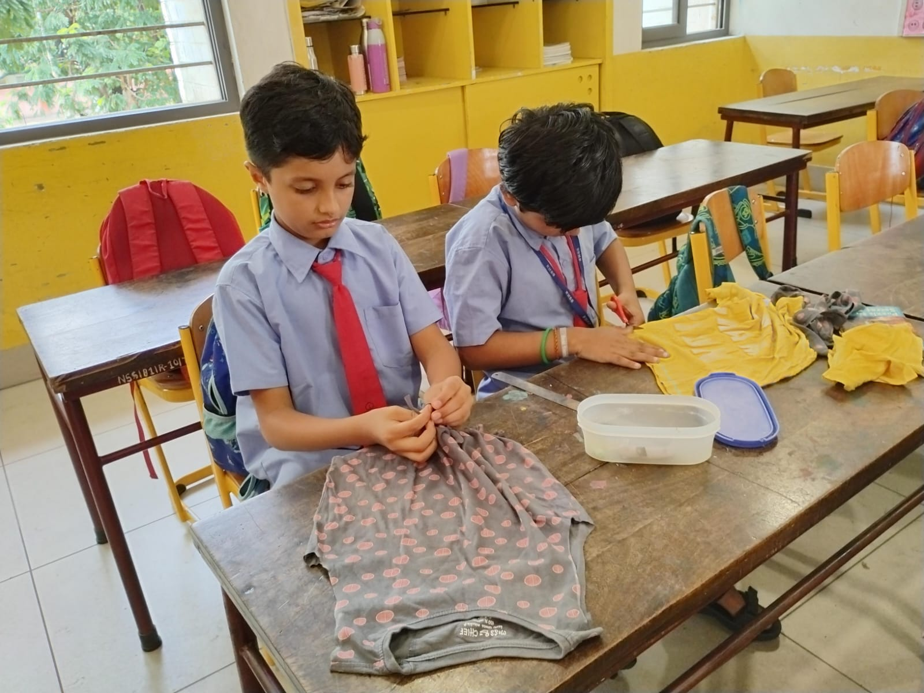
7. 🚫🥤 No Single-Use Plastic Week
Cloth Reusing Activity as part of the school’s waste-reduction and sustainability initiative. The activity helped students understand the importance of Reuse, Reduce and Recycle while developing their creativity and practical skills. It encouraged them to view old clothes as useful resources rather than waste. They have not used a single plastic bags this week and encouraged cloth bags to be used for their daily use.

Slide 9
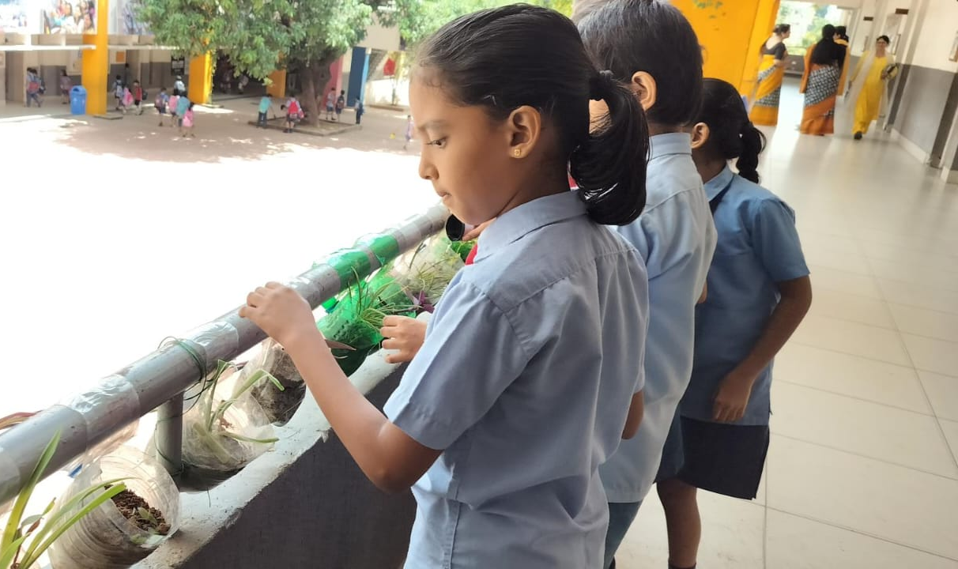
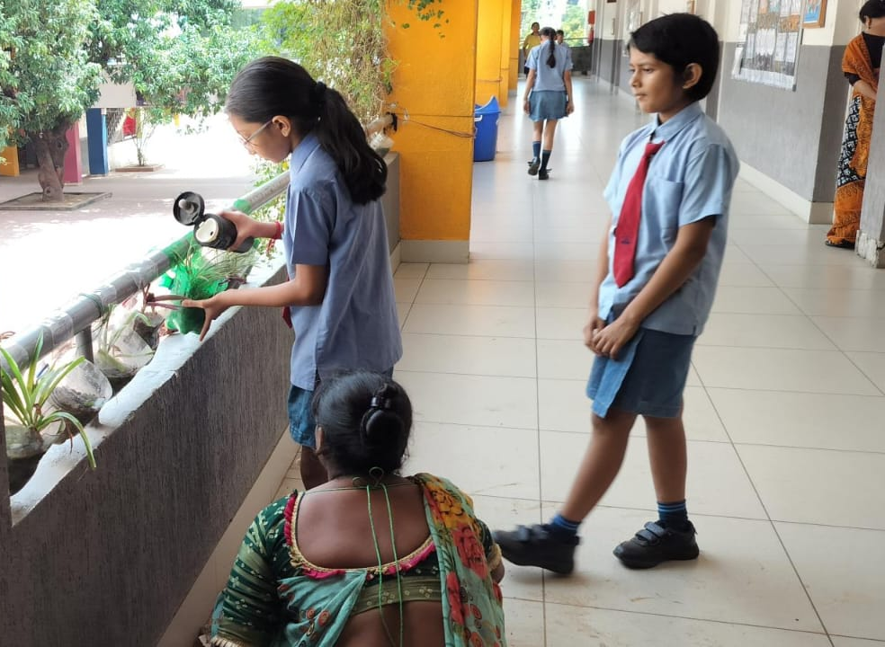
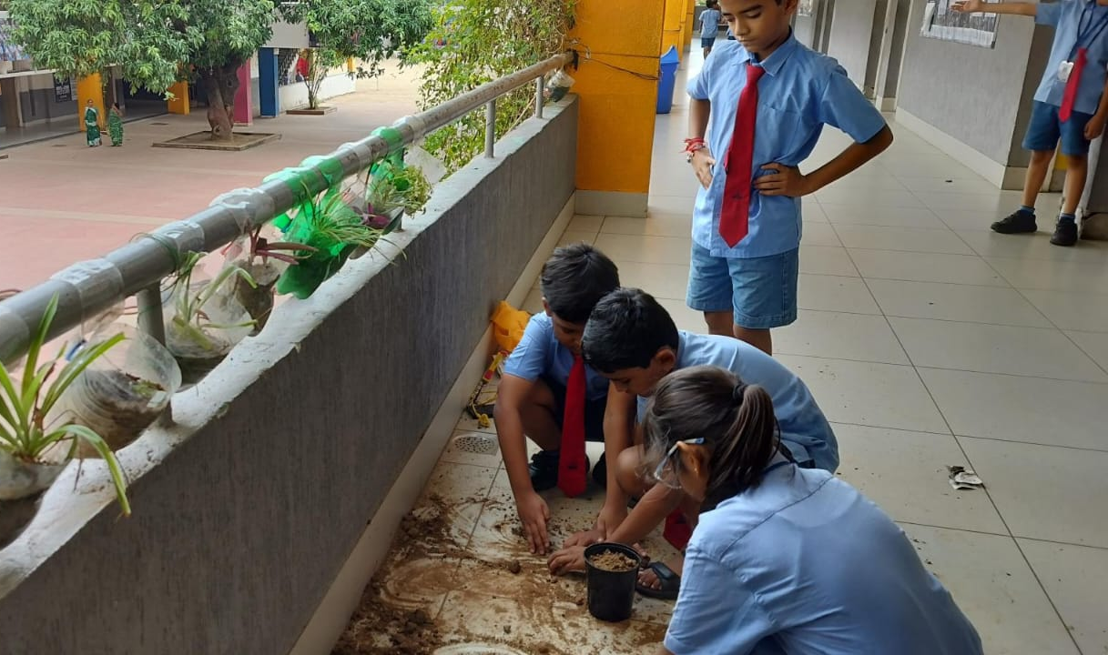
7. 🚫🥤 No Single-Use Plastic Week (B)
Students brought clean and unused plastic bottles and other reusable materials. With appropriate guidance, the bottles were converted into planters and filled with soil. Students then planted small flowering plants and seeds in them. The activity provided a practical understanding of the 3R principle – Reduce, Reuse and Recycle, with special emphasis on reuse. Similar bottle-planter activities are widely used in environmental education to demonstrate creative ways of reducing packaging waste.** “Reuse Today, Grow a Greener Tomorrow!”

Slide 10
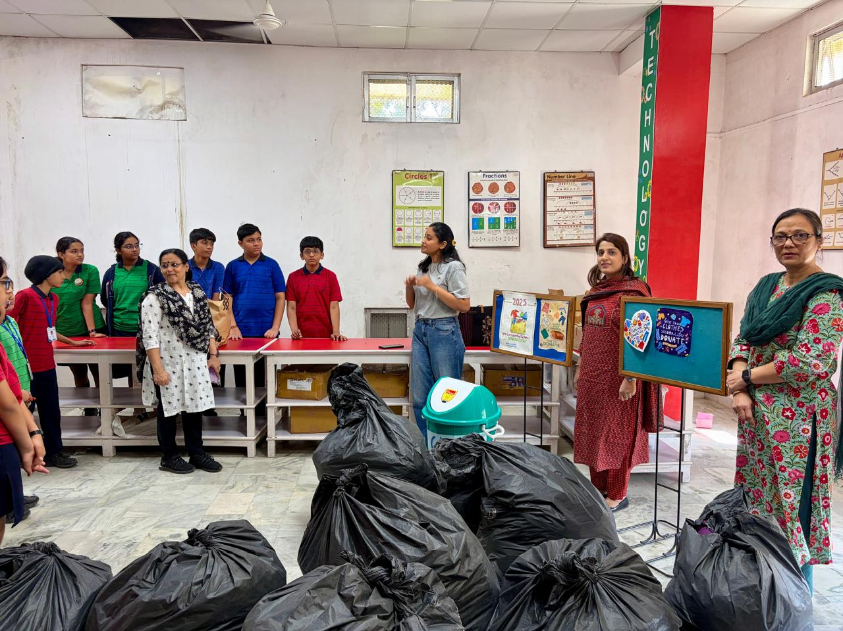
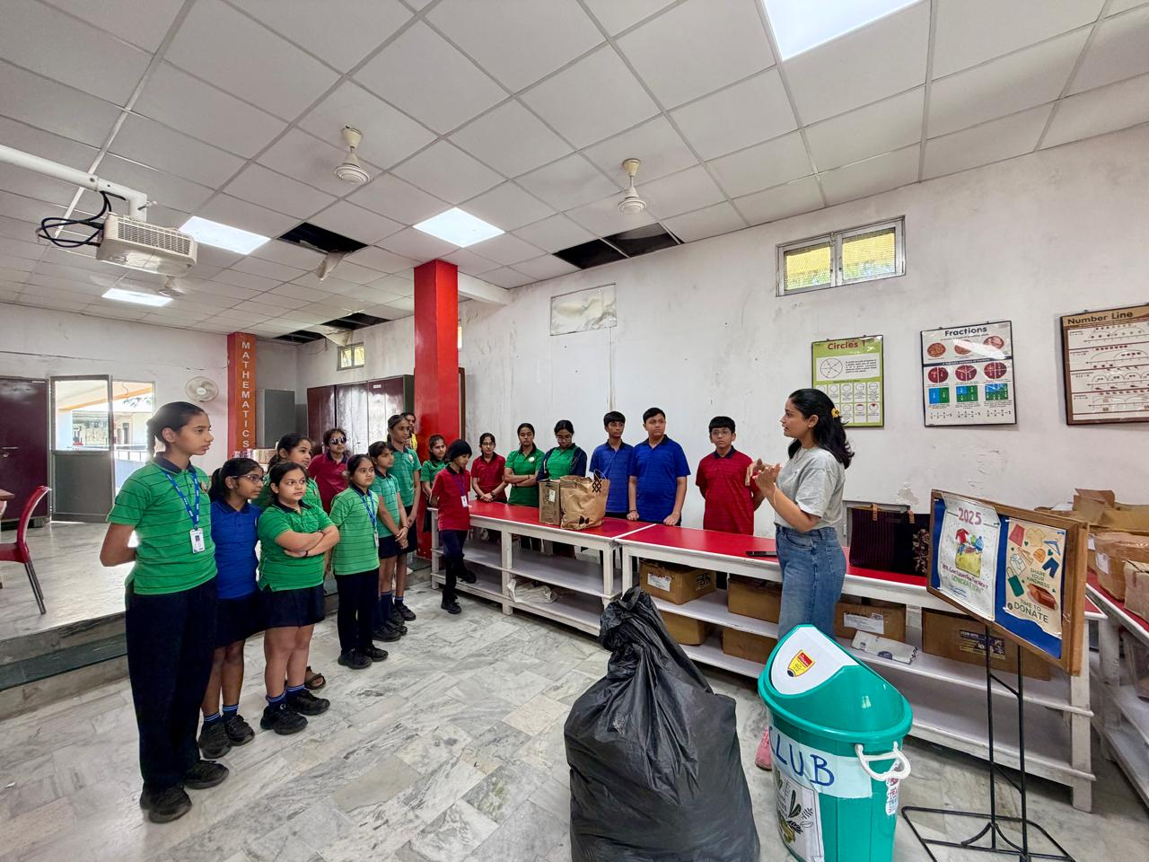
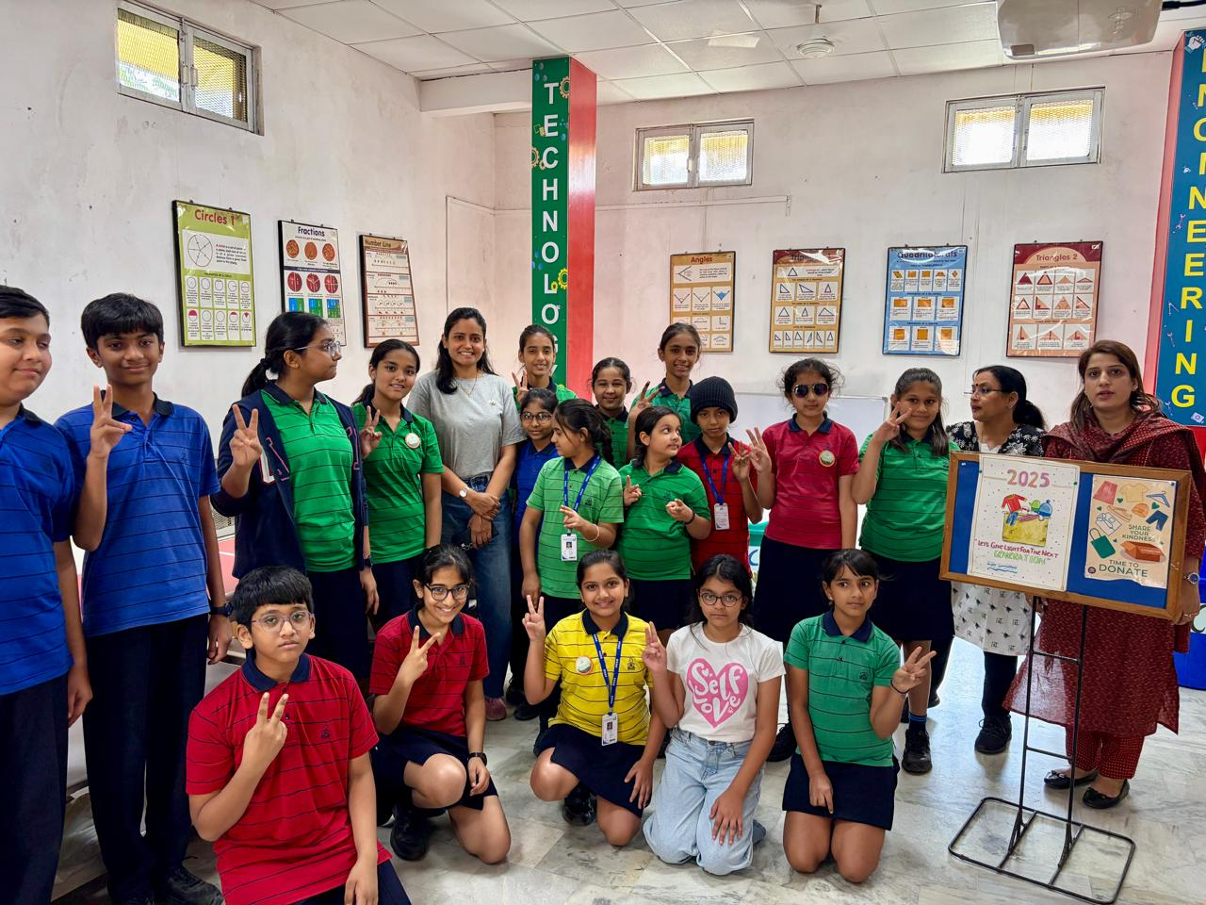
8. Expert & Community Interaction
Interaction session was conducted by the leading NGO of the city to spread the benefits of donating the used or unwanted clothes by donating to the needy people . They handed over the collected cloth for Recycling to Samkhya foundation.

Slide 11
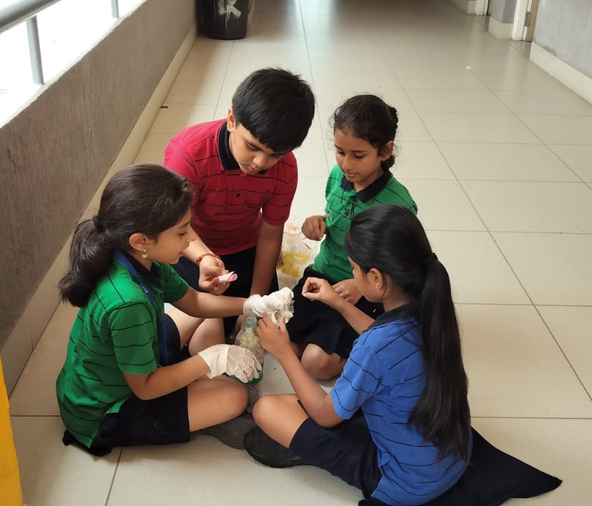
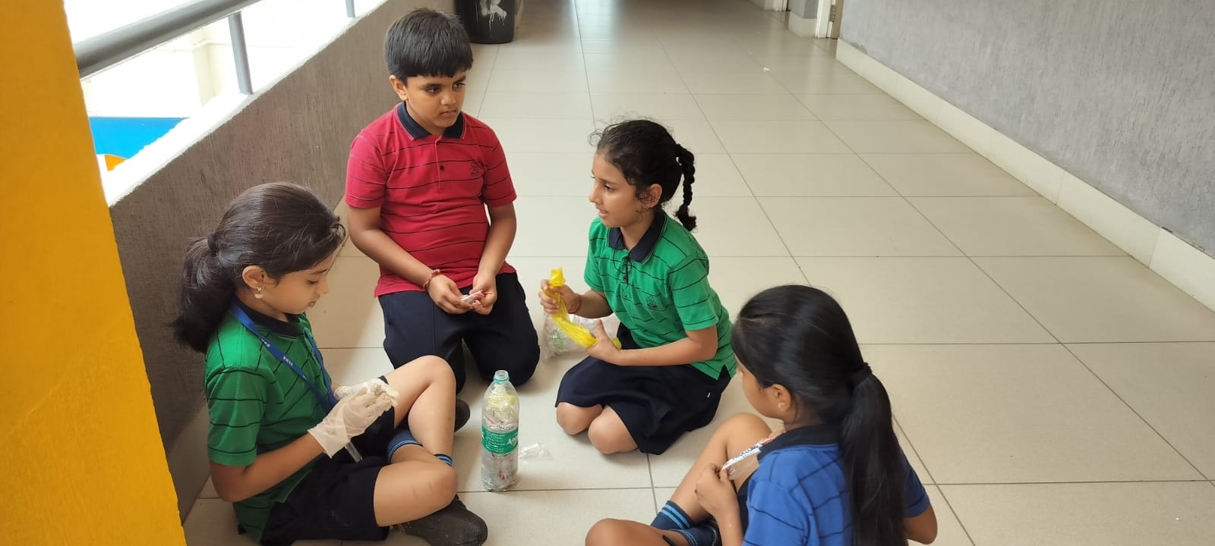
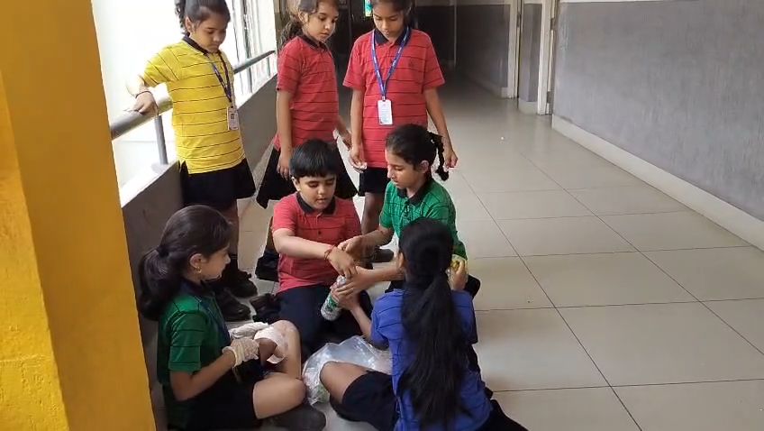
9a. 🎨 Creative Recycling & Upcycling
(ECO BRICKS)
Through hands-on participation, students developed awareness about the harmful effects of plastic waste and learned how everyday waste can be given a useful purpose. The activity also encouraged teamwork, creativity and environmental responsibility. Key Message: “Pack the plastic, build a solution, and protect our planet!”

Slide 12
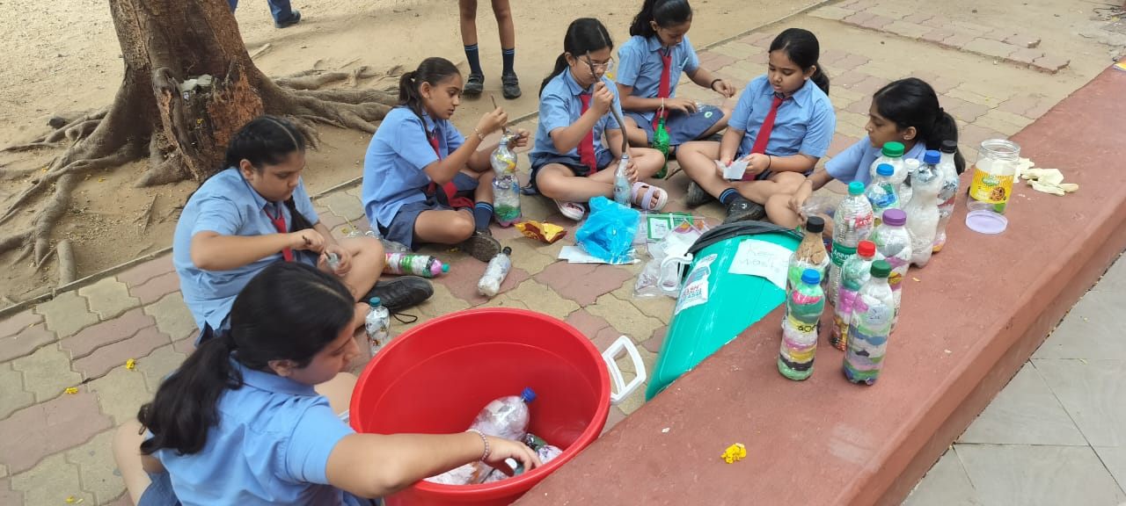
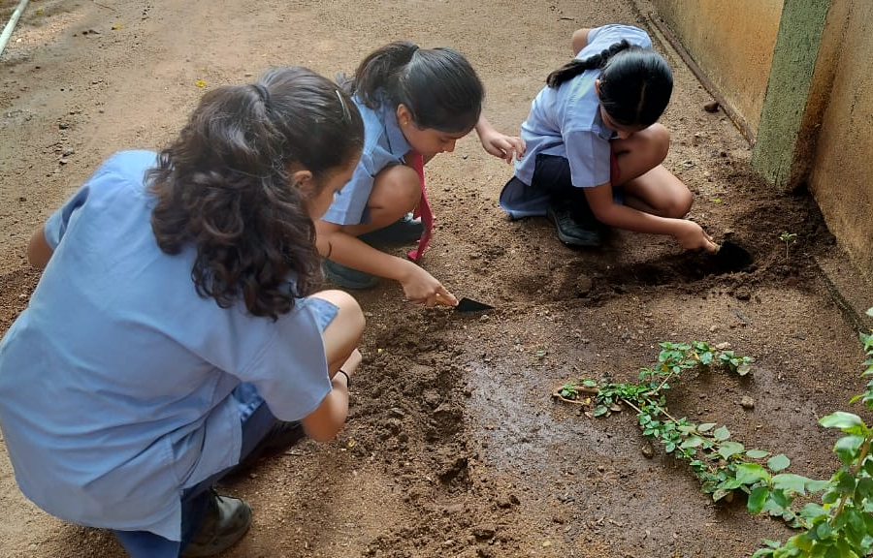
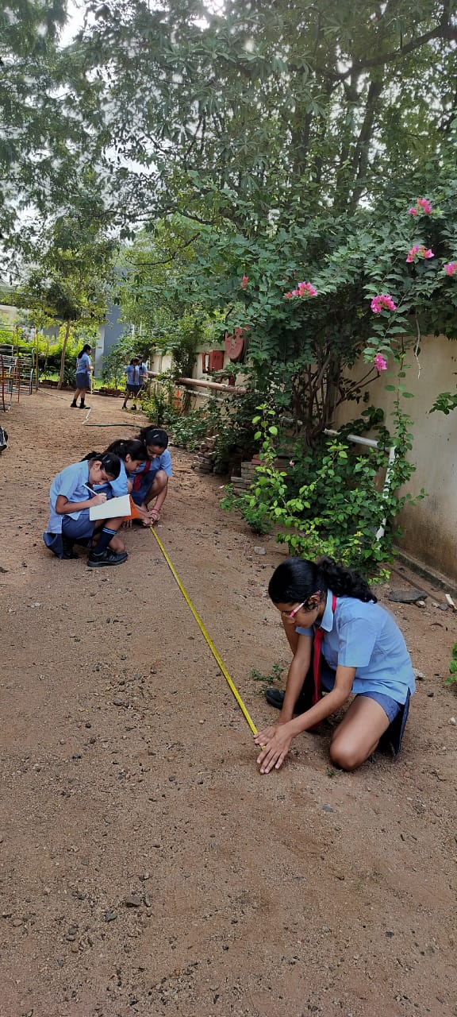
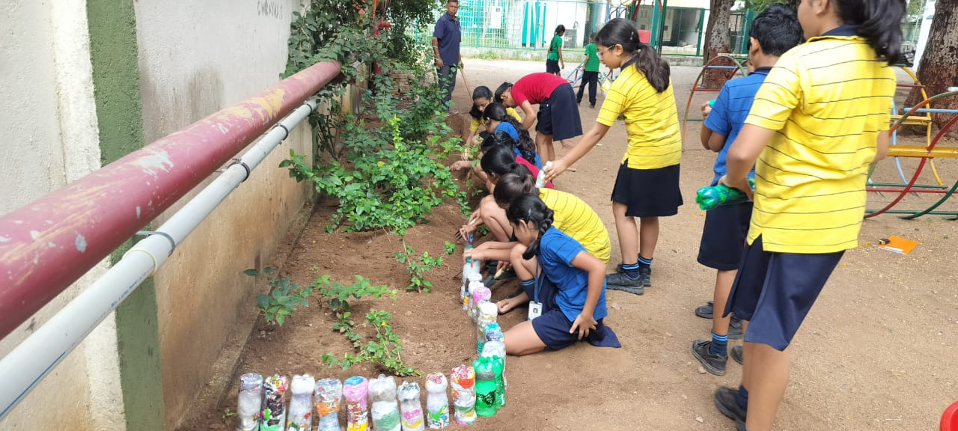
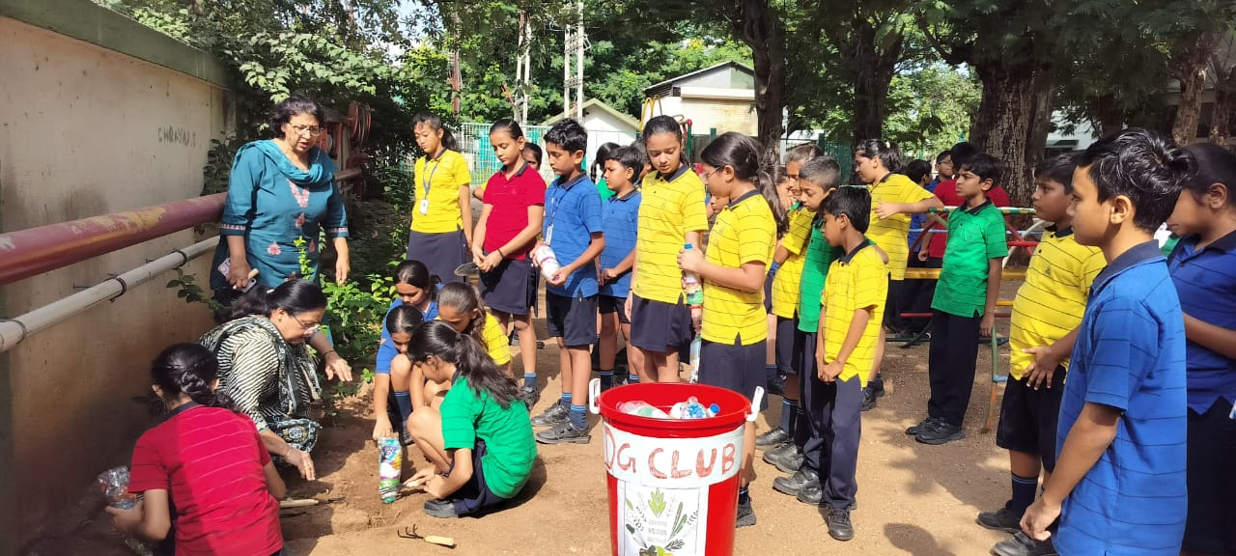
9b. Plastic Brick Installation
Eco-Brick Installation Activity aimed to promote the responsible reuse of plastic waste and how discarded materials can be transformed into useful and sustainable resources. Students installed the eco bricks along the school garden bed, creating a simple protective boundary around the plants.

Slide 13
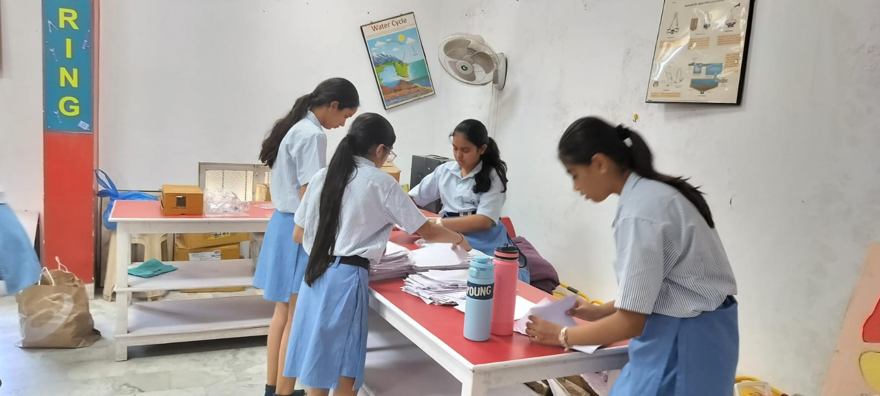
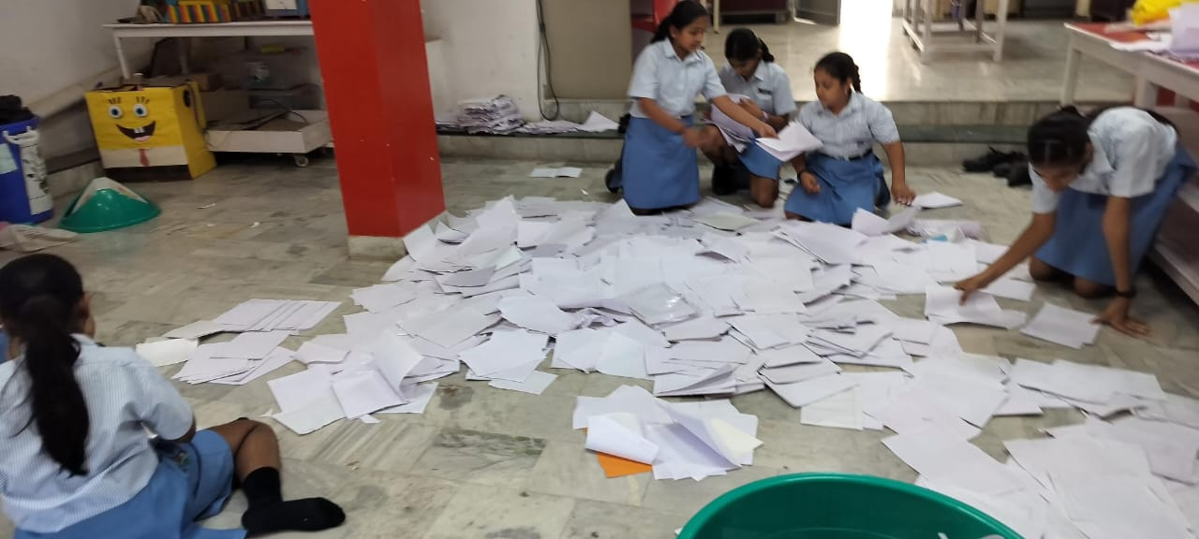
10. 🏘️ Community Awareness Drive
The students of Classes 3 to 8 of Navrachana Higher Secondary School, Sama enthusiastically participated in Purane Panne, Naya Rang, an eco-friendly initiative by Vadodara Marathon. It was heartening to observe that many students were already practicing the habit of reusing old notebooks and unused papers for classwork, practice, and creative activities. ♻️📚The initiative helped strengthen students’ understanding that small, conscious actions can make a big difference in conserving our environment.

Slide 14
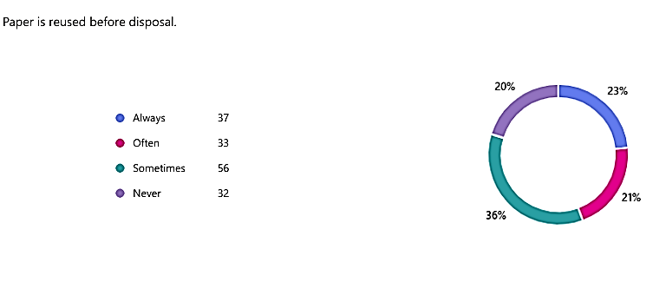
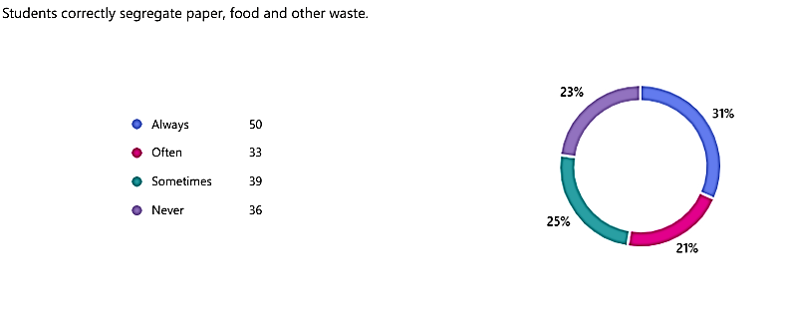

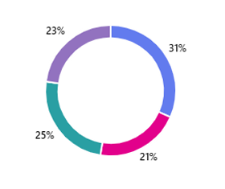
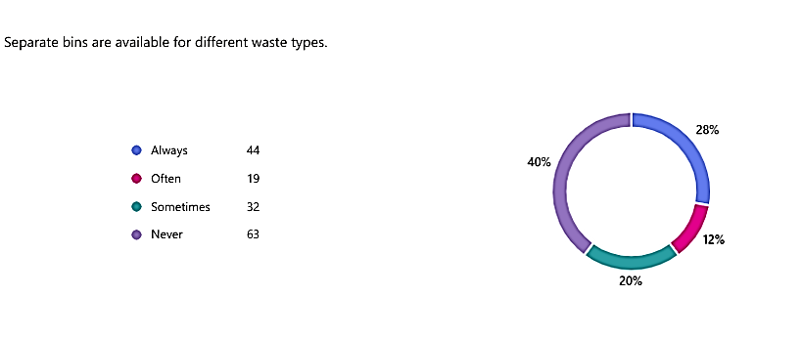
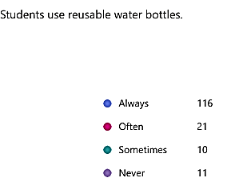
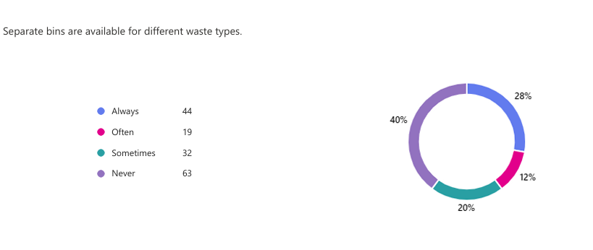
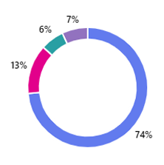







11. 📊 Evaluation & Impact Measurement
Collected data from teachers, parents and students
by filling up the survey form. The responses are
attached below.

Slide 15




12. Presentation & Sustainability Plan
As part of the Plastic Free July initiative, Navrachana Higher Secondary School, Sama successfully collected 76 kg of plastic waste during the month of July. The collected plastic was properly segregated and handed over to Eco Vision for responsible recycling.

