Slide 1

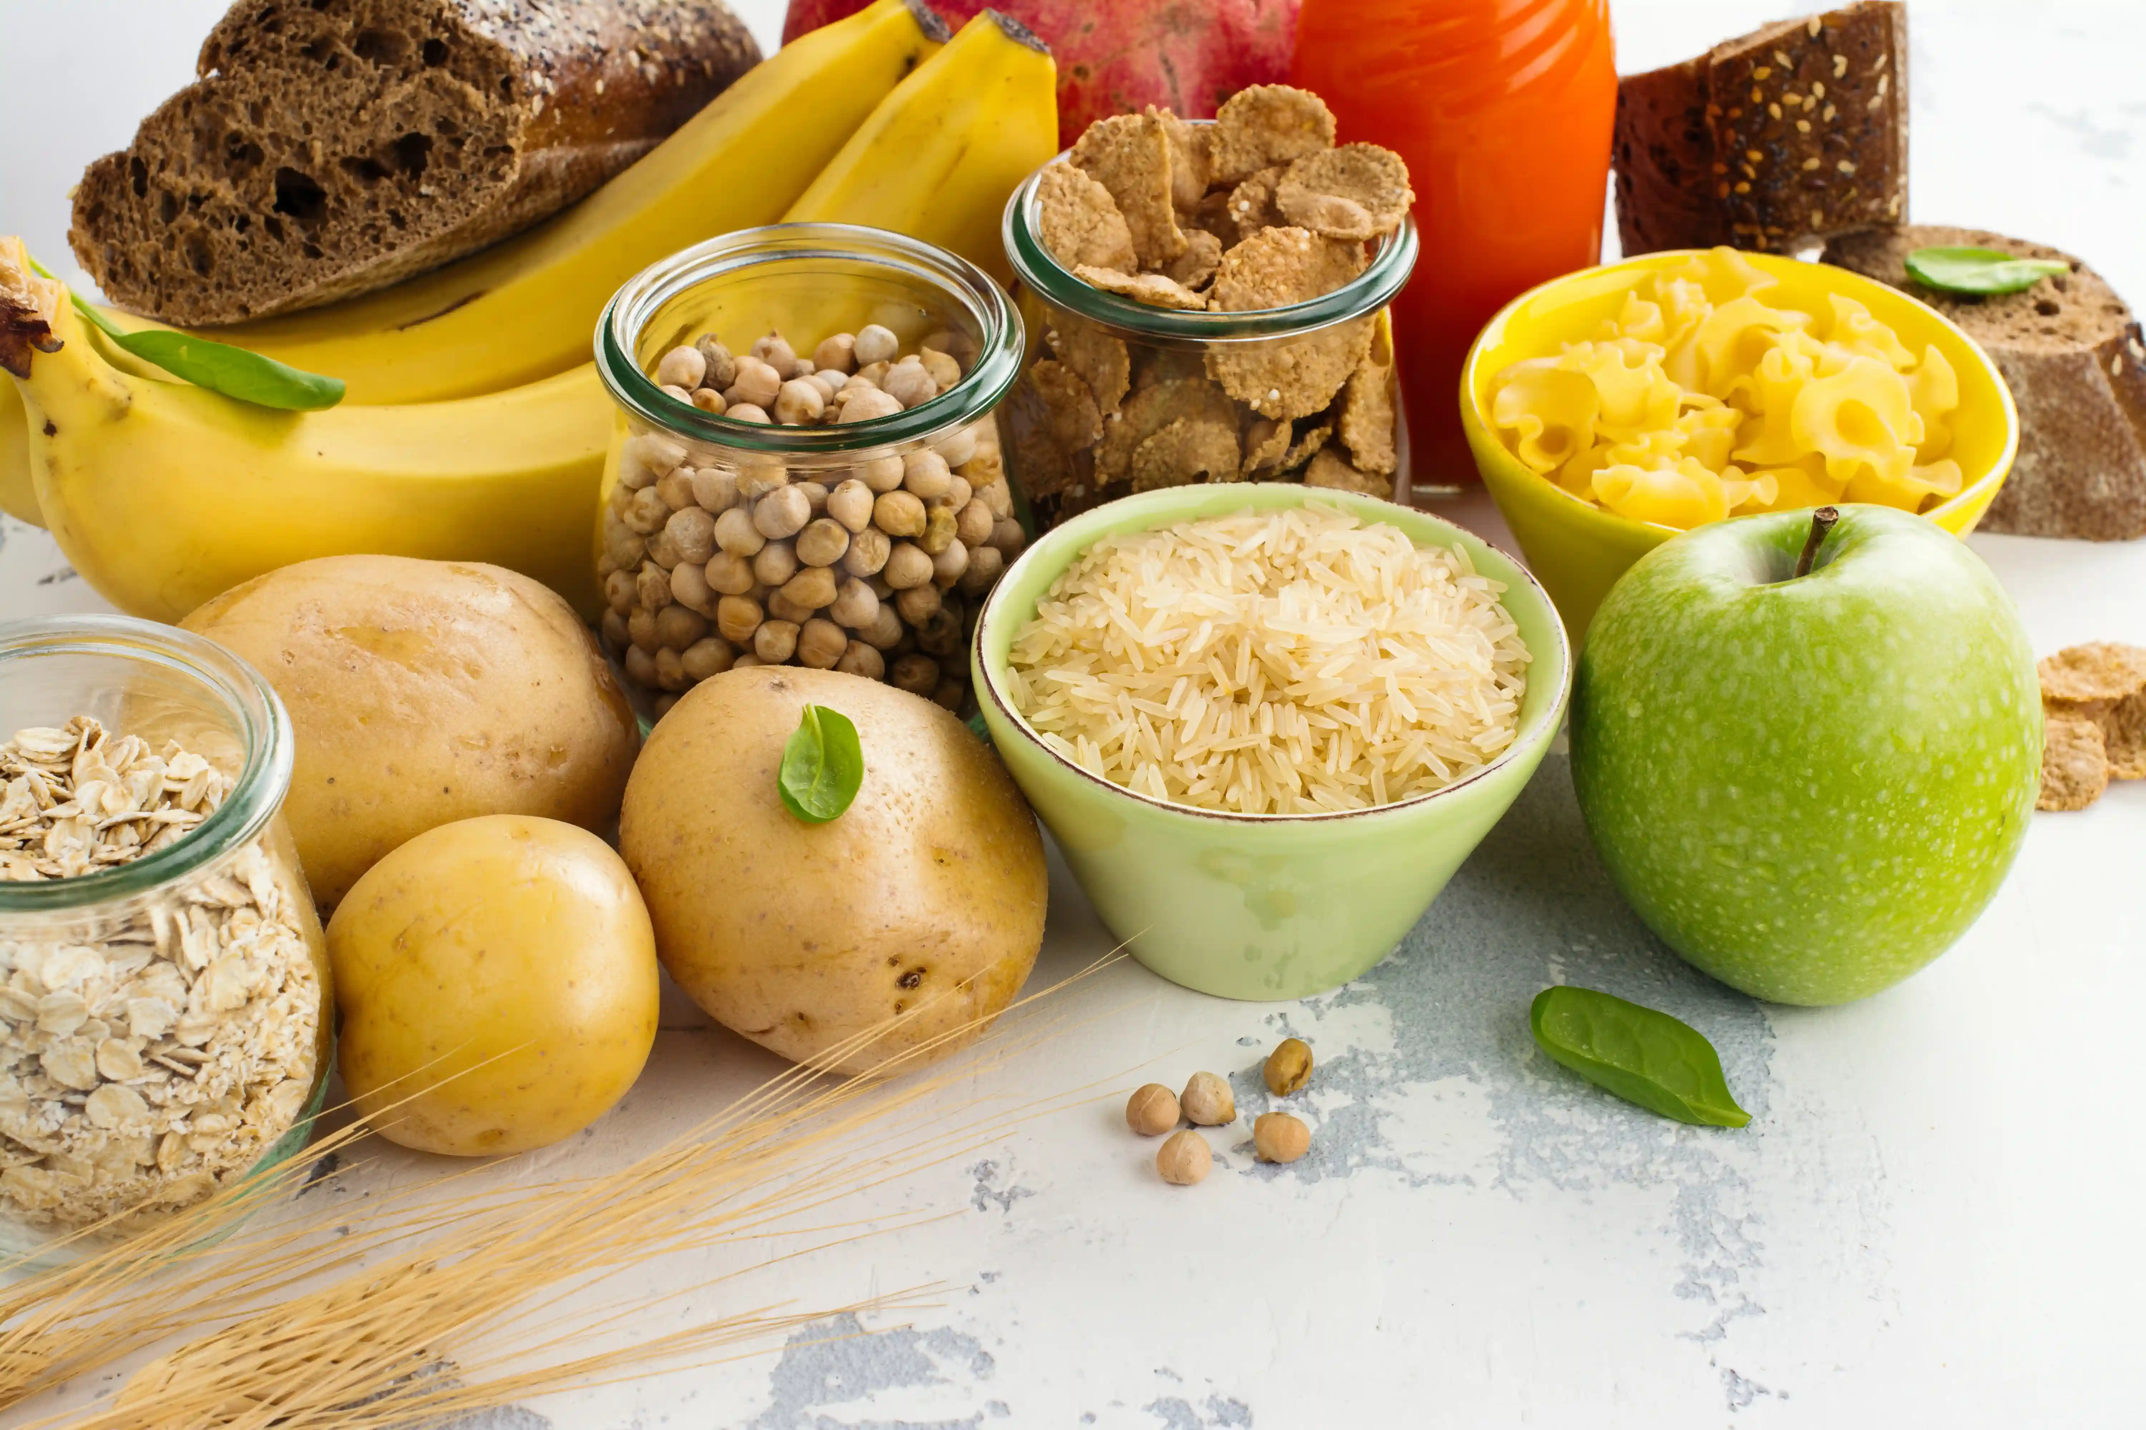
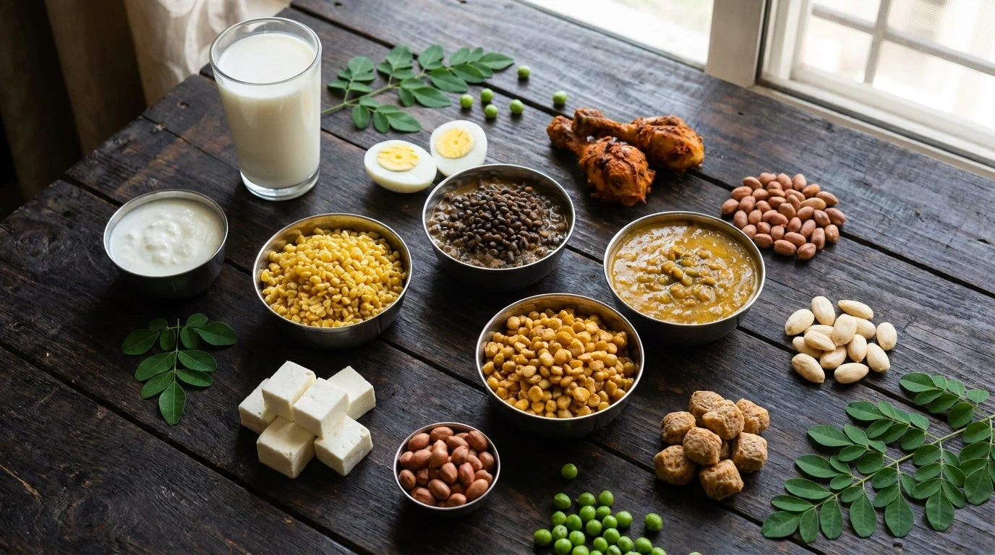
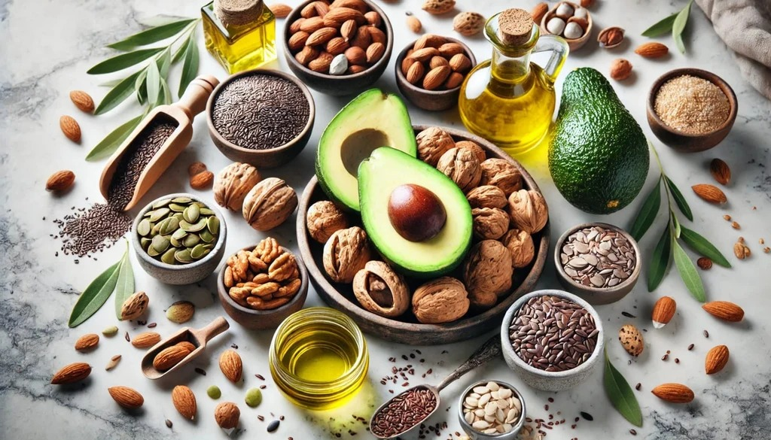
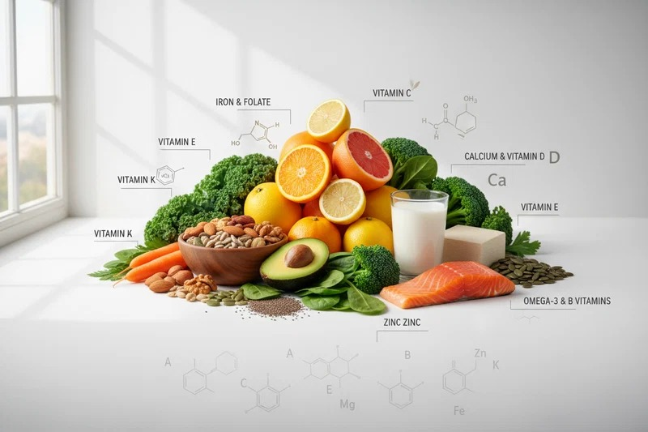
AL MADINA WELFARE ASSOCIATION'S
M.I. Hajwani English Medium School, Khed-Rtg.
SDG PROJECT
NUTRITION & HEALTHY MEALS
SDG 2 • ZERO HUNGER | SDG 3 • GOOD HEALTH & WELL-BEING
Understanding our food • Making healthier choices • Building healthy habits
Let’s begin with a simple question: What does our body get from the food we eat?

Slide 2
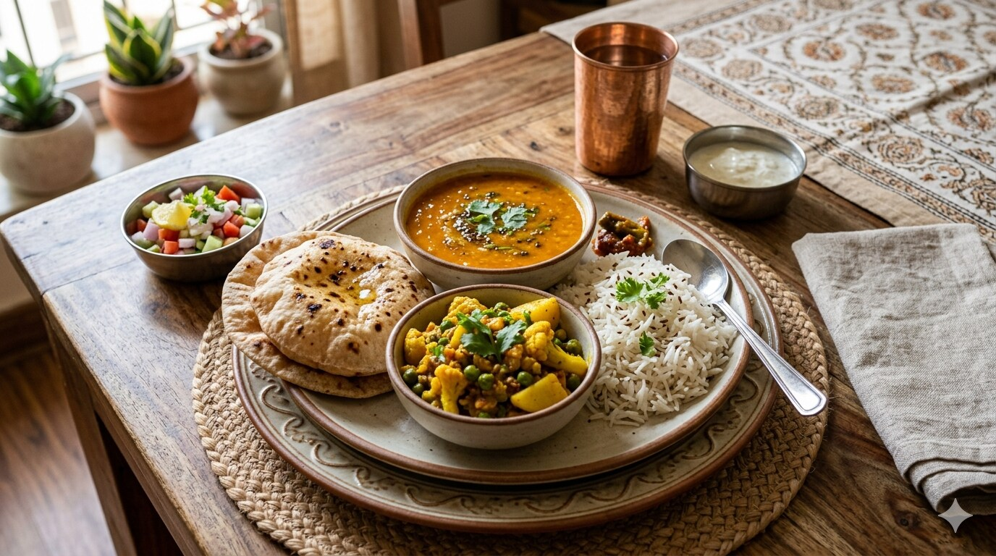
NUTRITION
What are we
actually eating?
Look at your own food before we talk about science.
Rice • Roti • Dal • Sabzi • Salad
What did you eat yesterday?
Nutrition & Healthy Meals • Std. 7–8
1

Slide 3
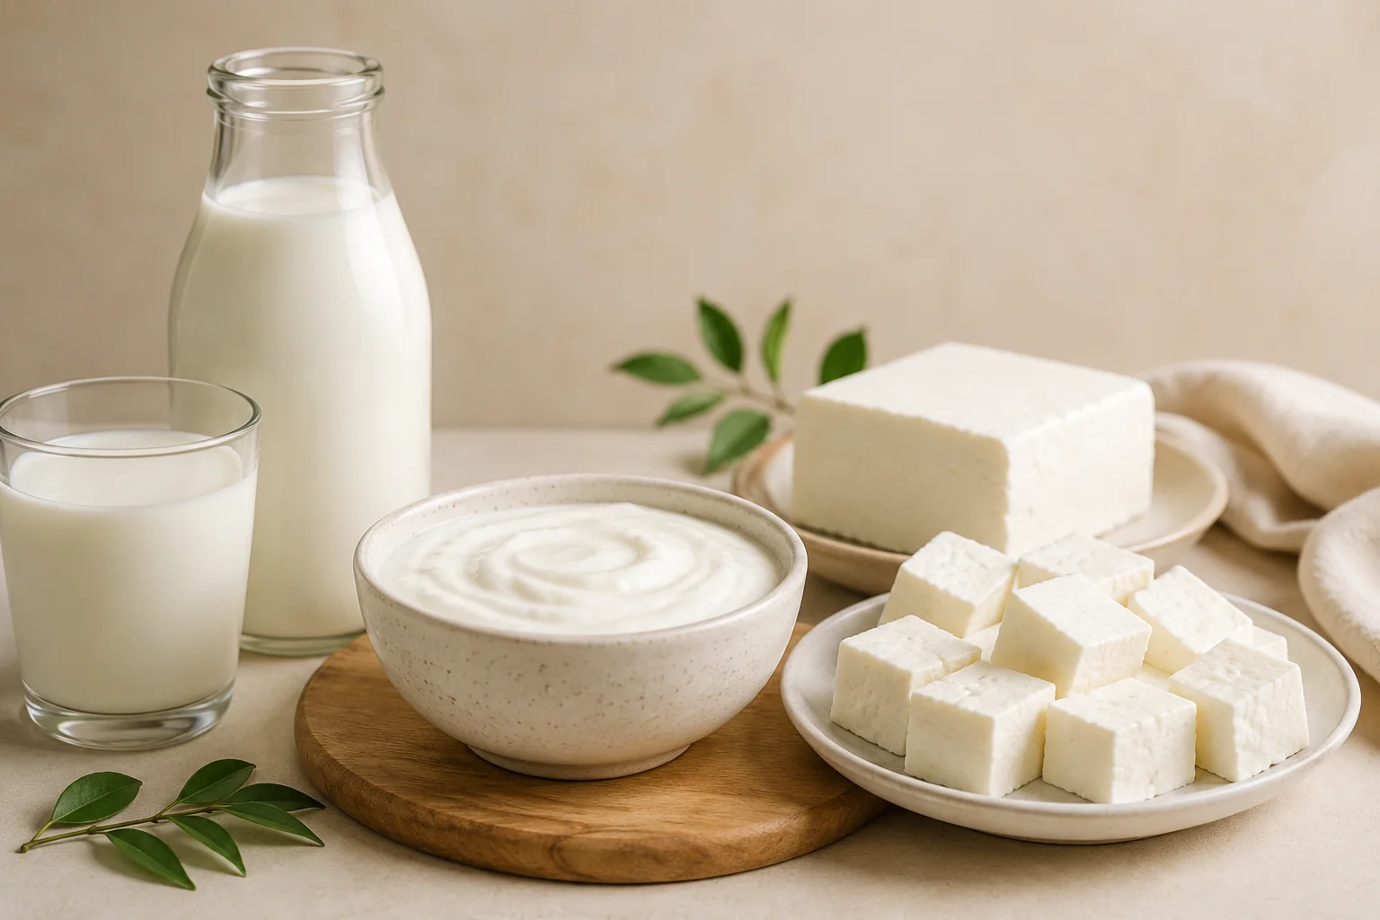
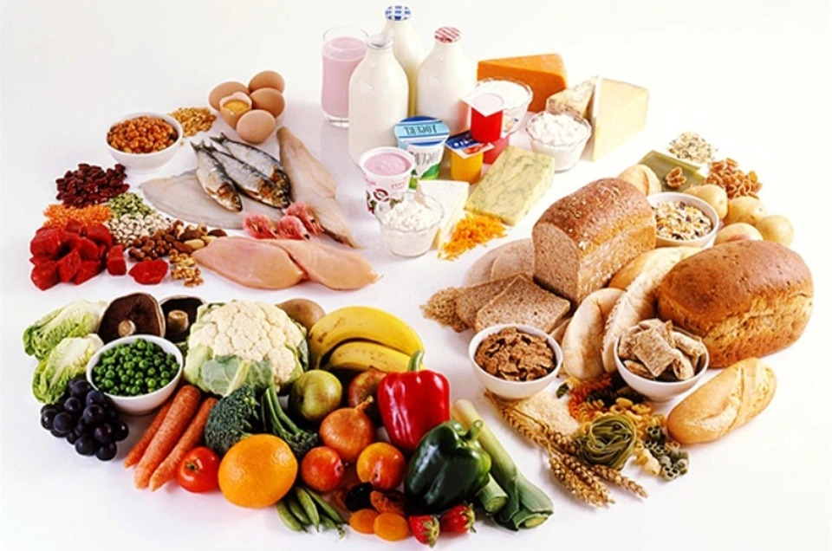
What Is Nutrition?
Food contains nutrients — useful substances that our body needs.
Nutrition = getting and using
nutrients from the food we eat.
Nutrients help us:
get energy
grow
repair
stay healthy
Ask: “Which nutrients do you think are in your lunch?”
Nutrition & Healthy Meals • Std. 7–8
2

Slide 4
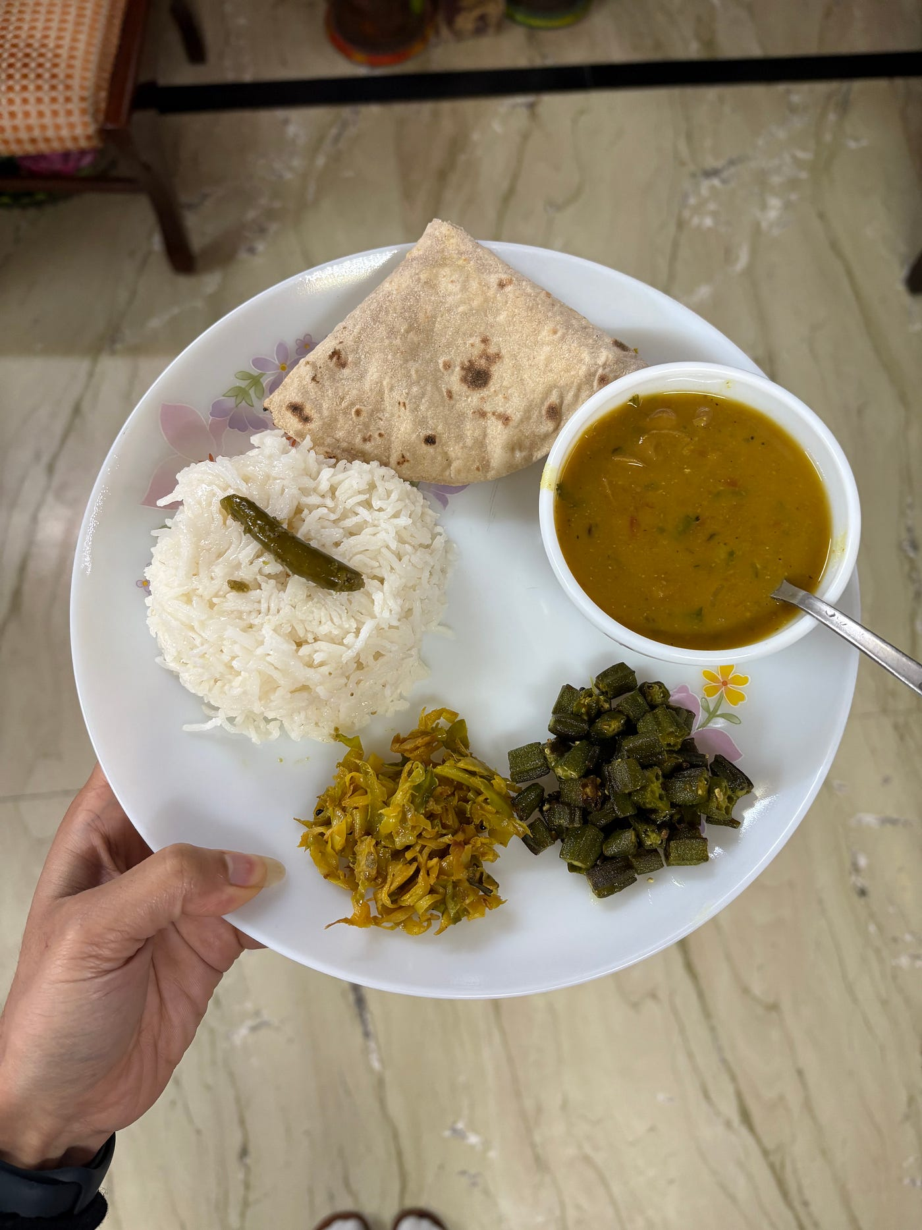
What Is a Healthy Diet?
A healthy diet is varied, balanced and not based on only one kind of food.
A healthy diet includes a variety of:
grains / cereals
protein foods
vegetables + fruits
healthy fats
water
The goal is not “perfect food” — it is a better overall pattern.
Nutrition & Healthy Meals • Std. 7–8
3

Slide 5
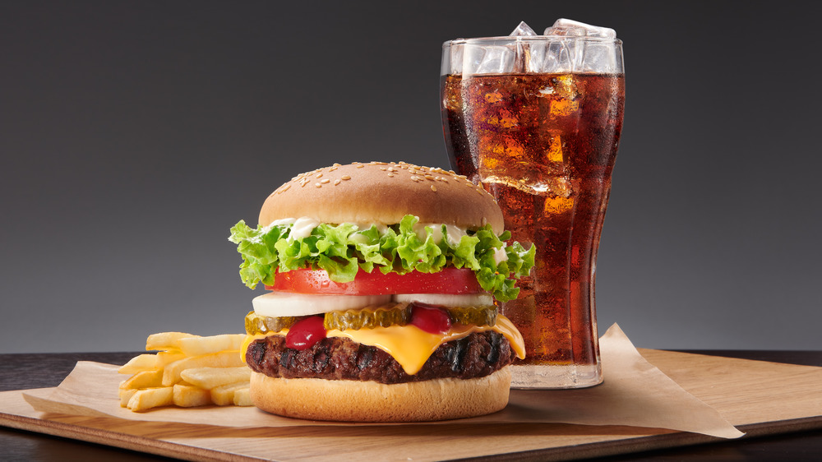
Why Should We Not Eat Too Much Junk Food?
It can be tasty — but frequent intake can crowd out more nutritious foods.
Often high in added sugar
Often high in salt
Can contain lots of unhealthy fat
Usually gives less variety of nutrients
Junk food ≠ “never”.
Think: LESS OFTEN, NOT ALL THE TIME.
Nutrition & Healthy Meals • Std. 7–8
4

Slide 6
Now: What Is a Balanced Diet?
A balanced meal combines different food groups in sensible proportions.
This is the picture we will now “break apart” and understand.
VEGETABLES
+ FRUITS
GRAINS /
CARBS
First → carbohydrates
Then → proteins
Then → fats
Then → vitamins & minerals + fibre
And → hydration
WATER
PROTEIN
SMALL AMOUNT
OF HEALTHY FAT
Let's look at each part.
Nutrition & Healthy Meals • Std. 7–8
5

Slide 7
1. Carbohydrates
Main role: provide energy for our everyday activities.
Sources of carbohydrates
Rice
Roti / bhakri
Poha / oats
Potato / sweet potato
Millets / other grains
Think of carbohydrates as
our body's everyday fuel.
Nutrition & Healthy Meals • Std. 7–8
6

Slide 8
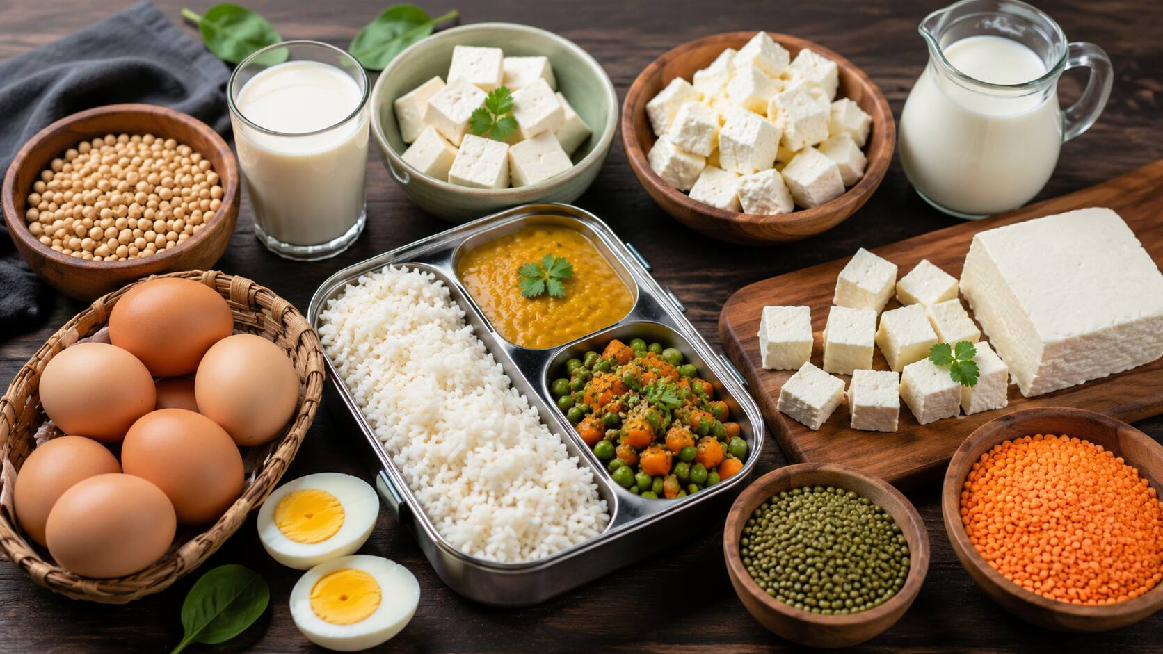
2. Proteins
Main role: growth and repair of body tissues.
Protein sources
Dal • lentils • beans
Chana • peas • soy
Eggs
Milk • curd • paneer
Nuts & seeds
Especially important during growth.
Nutrition & Healthy Meals • Std. 7–8
7

Slide 9
3. Fats
Fats are needed too — but we need them in appropriate amounts.
Sources of fats
Nuts
Seeds
Cooking oils
Avocado
Fish / eggs
Fat helps the body with energy,
cell functions and absorption of some vitamins.
Nutrition & Healthy Meals • Std. 7–8
8

Slide 10
4. Vitamins & Minerals
We need them in smaller amounts, but they are important for normal body functions.
Food sources
Fruits
Green leafy vegetables
Other vegetables
Milk / curd / paneer
Nuts, seeds & pulses
Examples: iron • calcium • vitamin C
vitamin A • vitamin B • vitamin D
Nutrition & Healthy Meals • Std. 7–8
9

Slide 11
5. Fibre (Roughage)
Fibre is found mainly in plant foods and helps keep digestion healthy.
Good sources of fibre
Fruits
Vegetables
Whole grains
Beans & lentils
Nuts & seeds
Simple idea:
more whole plant foods → more fibre.
Nutrition & Healthy Meals • Std. 7–8
10

Slide 12

6. Water & Hydration
Water is essential for many normal functions of the body.
Why do we need water?
Keeps the body hydrated
Helps regulate body temperature
Helps transport substances
Needed for many body processes
Water is the best everyday drink.
Nutrition & Healthy Meals • Std. 7–8
11

Slide 13
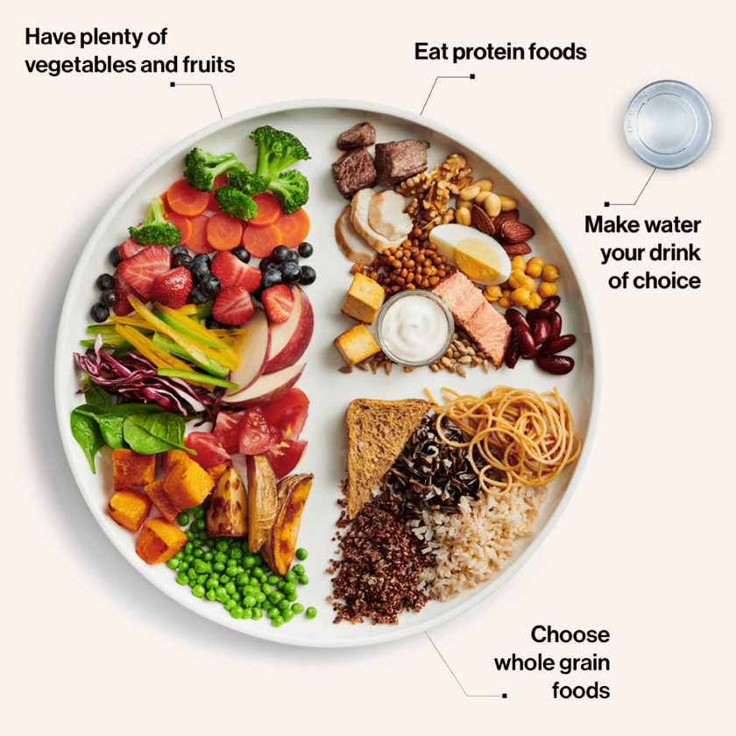
Put It All Together
A balanced meal is not one food — it is a combination.
Look at the plate and ask:
Where are the carbohydrates?
Where is the protein?
Where are the vegetables / fibre?
Where are the fats?
Where is the water?
Can your tiffin be made more balanced?
Nutrition & Healthy Meals • Std. 7–8
12

Slide 14
Your Turn
Before we begin the project, think about your own food habits.
Yesterday…
There is no need to give the “perfect” answer.
We are here to understand our habits and improve them.
What did you eat?
Did you have:
a carbohydrate
a protein food
NEXT →
Our Nutrition & Healthy Meals Project
vegetables / fruit
some healthy fat
enough water
Nutrition & Healthy Meals • Std. 7–8
13

