Slide 1
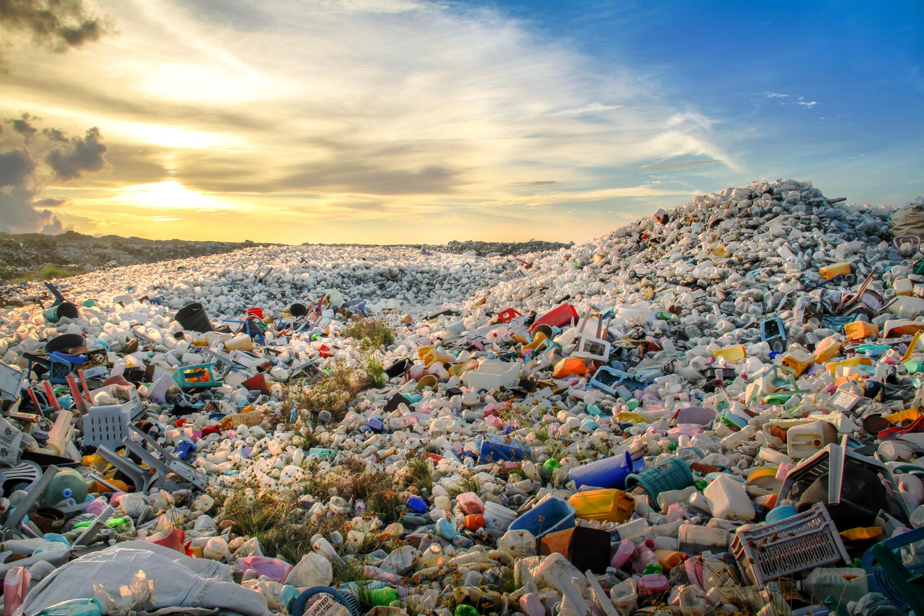
OUTCOMES OF THE AWARENESS CAMPAIGN
Waste Segregation & Plastic Reduction
From Awareness → Action → Measurable Change
Waste Segregation & Plastic Reduction Awareness Campaign

Slide 2
1. Campaign Objectives
Create awareness about correct waste segregation at source.
Help students identify wet, dry/recyclable and reject waste.
Reduce dependence on single-use plastics in school and at home.
Promote the 5Rs: Refuse, Reduce, Reuse, Repair and Recycle.
Encourage students to become responsible waste-management ambassadors.
Waste Segregation & Plastic Reduction Awareness Campaign

Slide 3
2. Awareness Activities Conducted
Awareness session
Plastic pollution, segregation and 5Rs
Waste-bin demonstration
Correct disposal using labelled bins
Leaflet campaign
Messages shared with students and parents
Pre-survey
Baseline awareness and practices recorded
Action activity
Plastic reduction and segregation practices
Post-survey & audit
Changes measured after the campaign
Waste Segregation & Plastic Reduction Awareness Campaign

Slide 4
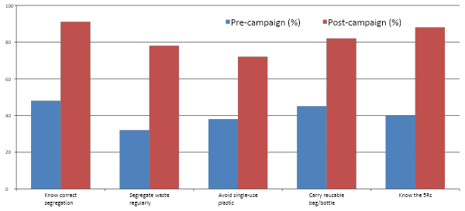
3. Pre- and Post-Campaign Survey Results
Illustrative sample data: approx. 90 respondents
Waste Segregation & Plastic Reduction Awareness Campaign

Slide 5

4. What Changed After the Campaign?
Knowledge of correct waste segregation increased from 48% to 91%.
Regular segregation at source increased from 32% to 78%.
Students reporting avoidance of single-use plastic increased from 38% to 72%.
Use of reusable bags/bottles increased from 45% to 82%.
Awareness of the 5Rs increased from 40% to 88%.
Overall, the post-survey indicates a clear movement from awareness towards everyday action.
Waste Segregation & Plastic Reduction Awareness Campaign

Slide 6
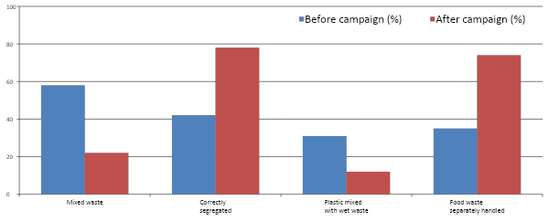
5. Waste Segregation Audit – Observed Outcome
Waste Segregation & Plastic Reduction Awareness Campaign

Slide 7
6. Plastic Reduction Outcomes
Single-use plastic items were identified and discussed with students.
Students were encouraged to use reusable water bottles, lunch boxes and bags.
Plastic carry bags were discouraged during the campaign.
The campaign promoted refusal of unnecessary plastic packaging.
Illustrative audit result: single-use plastic waste reduced by approximately 35% after the campaign period.
Students began discussing practical alternatives such as cloth/jute bags and reusable containers.
Waste Segregation & Plastic Reduction Awareness Campaign

Slide 8
7. Behavioural Changes Observed
Before
Waste was often placed in the nearest bin without checking the category.
After
Students showed greater attention to the correct waste bin.
Before
Single-use plastic was commonly accepted as convenient.
After
More students reported carrying reusable alternatives.
Waste Segregation & Plastic Reduction Awareness Campaign

Slide 9
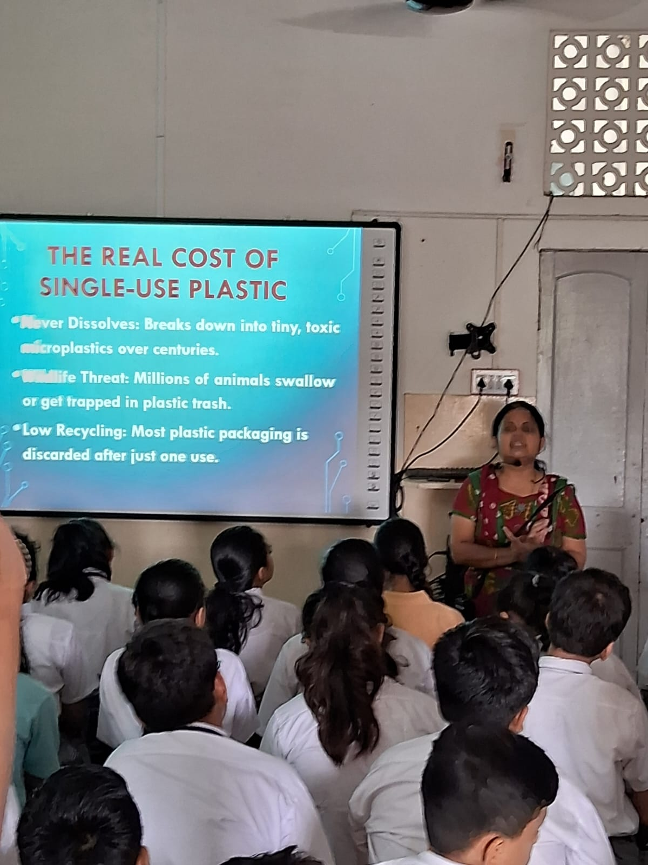
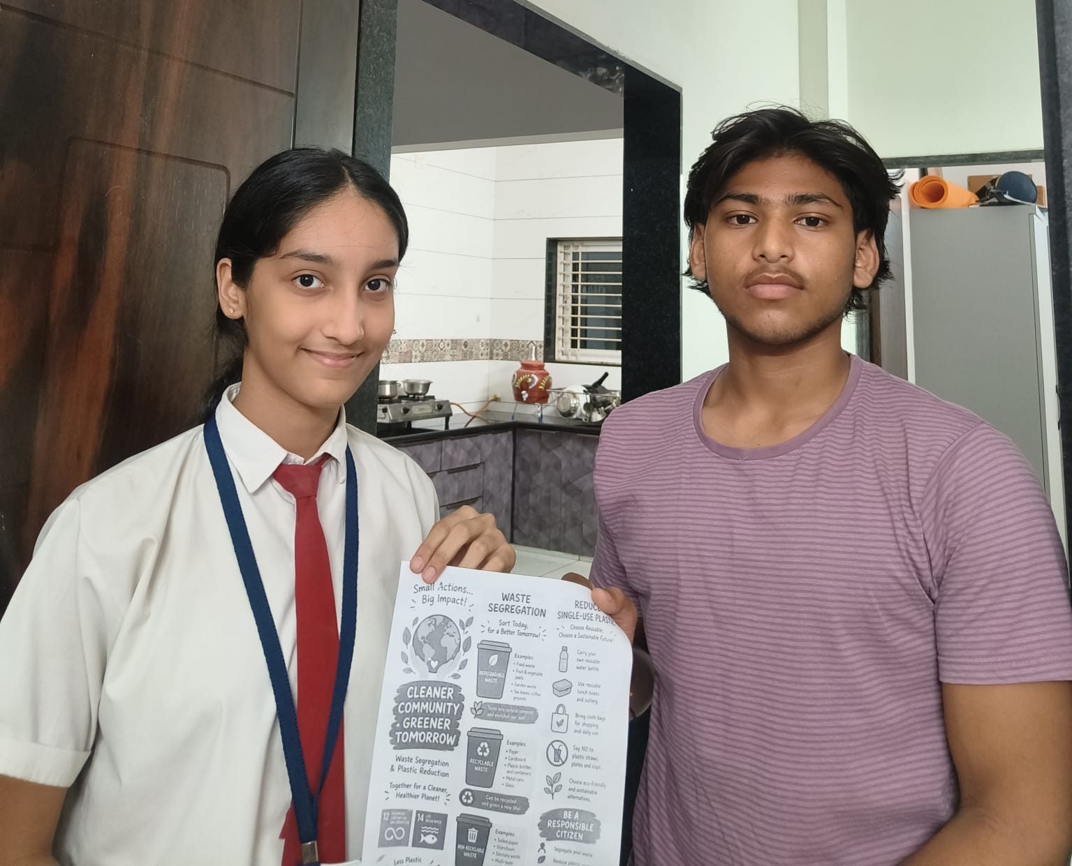
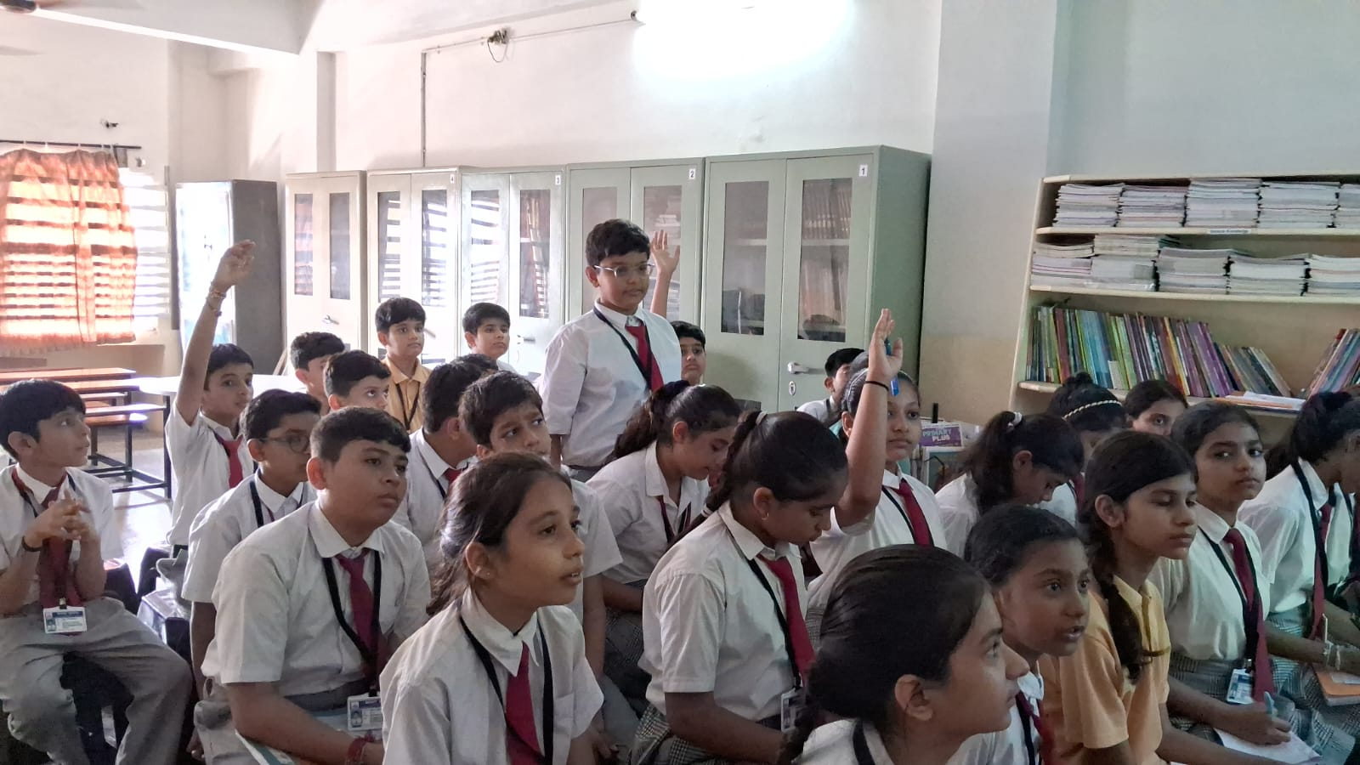

Slide 10
8. Wider Impact of the Campaign
Students became more confident in explaining waste categories to peers.
Awareness messages reached families through leaflets and student conversations.
The campaign connected classroom learning with a real-life environmental issue.
Students understood that segregation must happen at the point where waste is generated.
The activity encouraged responsible citizenship and sustainable habits.
The school can continue the initiative through periodic waste audits and reminder campaigns.
Waste Segregation & Plastic Reduction Awareness Campaign

Slide 11

9. Challenges Identified
Some waste was still placed in the wrong bin.
Plastic packaging remains difficult to avoid completely.
Correct segregation needs regular reminders and monitoring.
Behavior change takes time and requires participation from students, staff and families.
Waste reduction should be followed by responsible reuse and recycling—not only disposal.
Waste Segregation & Plastic Reduction Awareness Campaign

Slide 12
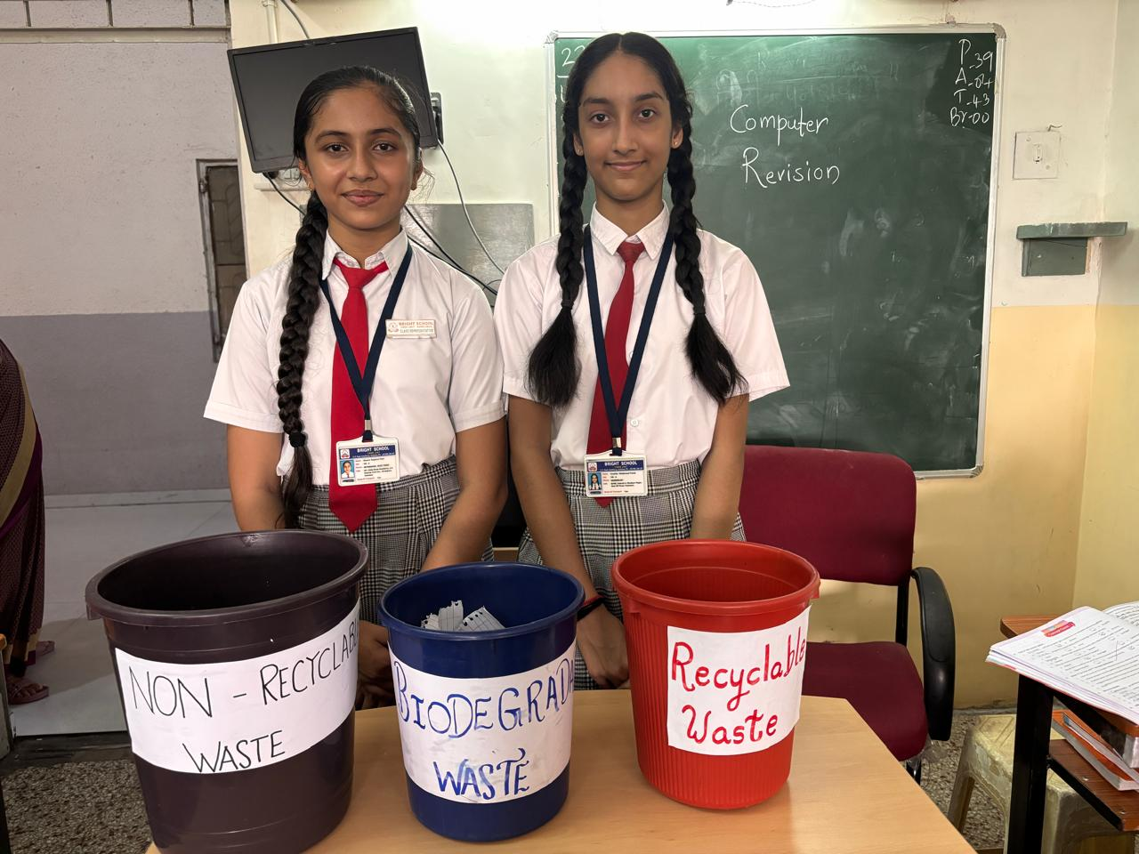
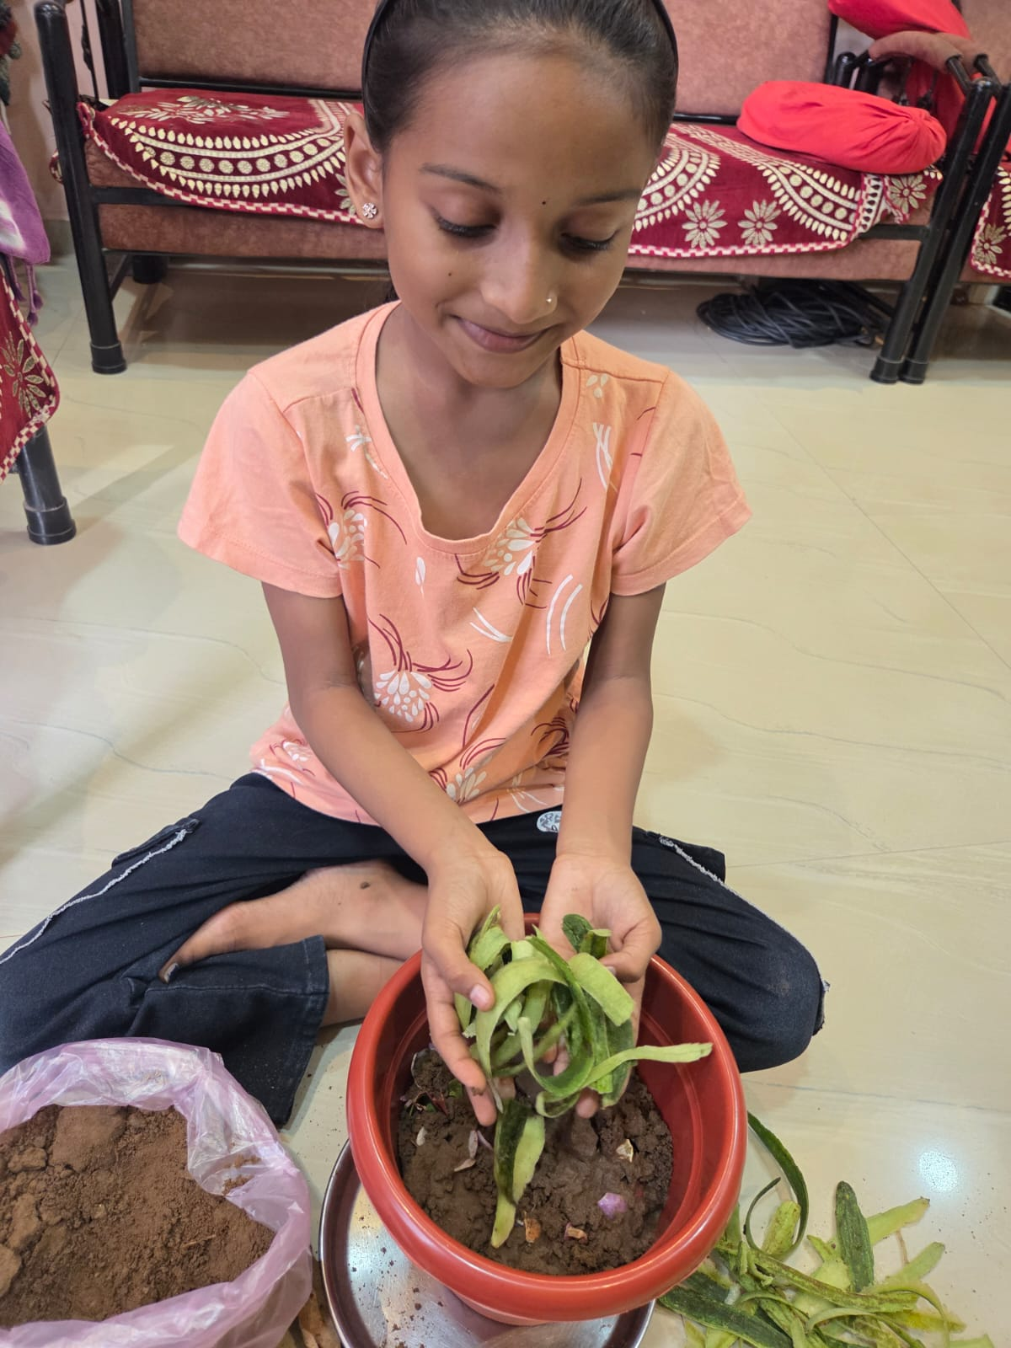
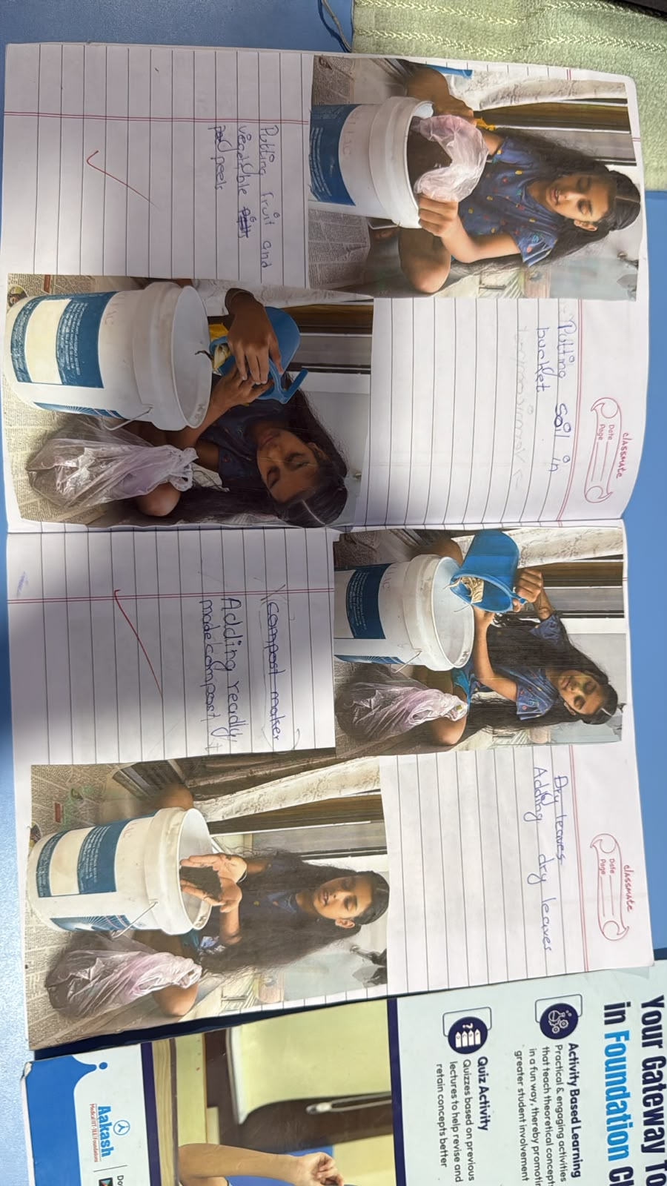

Slide 13

10. Sustaining the Change
Conduct a short waste audit every month.
Display simple bin-label posters near waste collection points.
Continue a 'No Single-Use Plastic' awareness drive.
Organise reusable-bag / reusable-bottle challenges.
Track plastic waste quantity over time.
Share progress with students and parents through school communication channels.
Recognise classes or groups that consistently demonstrate correct segregation.
Waste Segregation & Plastic Reduction Awareness Campaign

Slide 14
11. Conclusion
The campaign helped students move from awareness to action.
• Improved knowledge of waste segregation
• Better day-to-day segregation practices
• Greater use of reusable alternatives
• Reduced dependence on single-use plastic
• Stronger sense of environmental responsibility
Waste Segregation & Plastic Reduction Awareness Campaign

Slide 15

🌍 Outcomes & Way Forward
Bins Installed: 3‑bin system across classrooms, canteen, corridors, and common areas.
Daily Monitoring: Sahayak teams recording segregation and guiding peers.
Improved Segregation: Classrooms and library show reduced mixed waste.
Awareness Impact: Posters, assemblies, and reminders increased student participation.
Plastic Reduction: Early signs of fewer single‑use bottles and disposable packaging.
“Segregate Today, Sustain Tomorrow!”
Waste Segregation & Plastic Reduction Awareness Campaign

