Slide 1
Waste Audit & Assessment Report
Week 2
Presented by Sahayaks (Student Monitors- Koshika 8A and Dharmi 8A)
School Sustainability Campaign
School Sustainability Campaign • Week 2 | 1

Slide 2
Objectives
Identify
Identify types and quantities of waste generated in school
Assess
Assess disposal practices and plastic-use habits
Establish
Establish baseline data for comparison
School Sustainability Campaign • Week 2 | 2

Slide 3
Methodology
• Survey & observation across classrooms, corridors, canteen, and common areas
• Data collection tools:
Student monitoring sheets
Used to record
observations
Sahayak-supervised bin checks
Supported regular waste checks
Plastic-use questionnaire
Captured student plastic-use habits
School Sustainability Campaign • Week 2 | 3

Slide 4
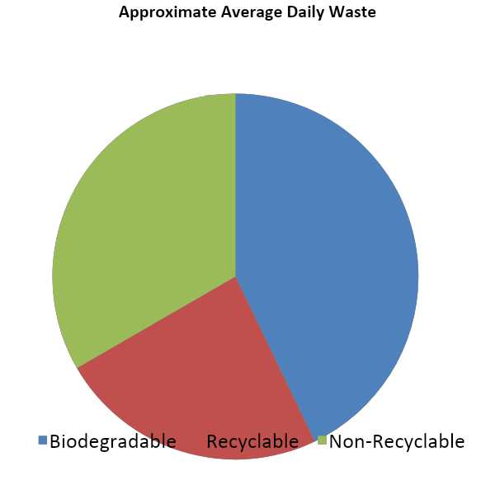
Waste Categories
Average daily quantity and common sources
🟢 Biodegradable
4–5 kg • Canteen leftovers, fruit peels
🔵Recyclable
2–3 kg • Paper scraps, notebooks, cardboard
⚫ Non-Recyclable
3–4 kg wrappers, single-use plastics• Plastic use bottles
School Sustainability Campaign • Week 2 | 4

Slide 5
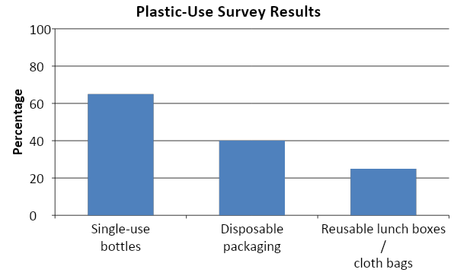
Plastic-Use Pre-Survey Outcomes
65%
use single-use plastic bottles
40%
bring food in disposable packaging
25%
use reusable lunch boxes or cloth bags
School Sustainability Campaign • Week 2 | 5

Slide 6
Key Observations
Observation 1
Biodegradable waste is the largest category
Observation 2
Recyclable paper is often mixed with non-recyclables
Observation 3
High dependence on single-use plastics
Observation 4
Awareness of segregation is low
School Sustainability Campaign • Week 2 | 6

Slide 7
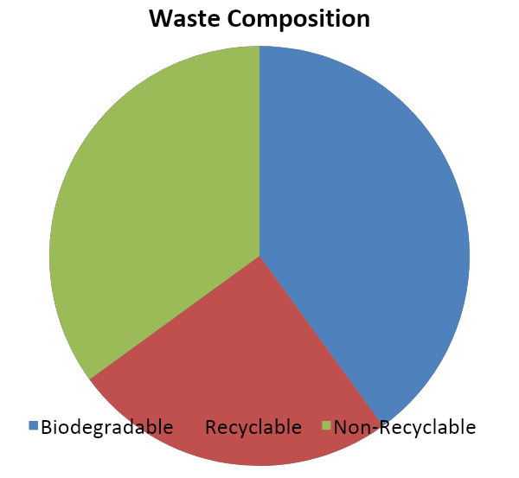
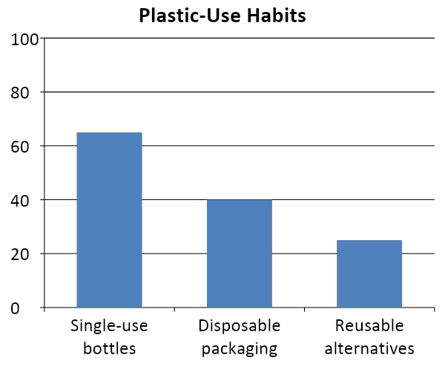
Analysis
Waste composition and plastic-use comparison
School Sustainability Campaign • Week 2 | 7

Slide 8
Expected Outputs
Waste Audit Report
Baseline data recorded
Survey Analysis
Student plastic-use habits documented
Charts & Graphs
For Week 3 awareness campaigns
School Sustainability Campaign • Week 2 | 8

Slide 9
Week 3 Awareness & Research
Step 1
Research nutrients and healthy eating
Step 2
Link junk food packaging to waste generation
Step 3
Create posters and presentations
Step 4
Promote reusable habits
School Sustainability Campaign • Week 2 | 9

Slide 10
“Together we can make
our school
cleaner and greener!”
Presented by Sahayaks – Student Monitoring Team
School Sustainability Campaign • Week 2 | 10

