Slide 1

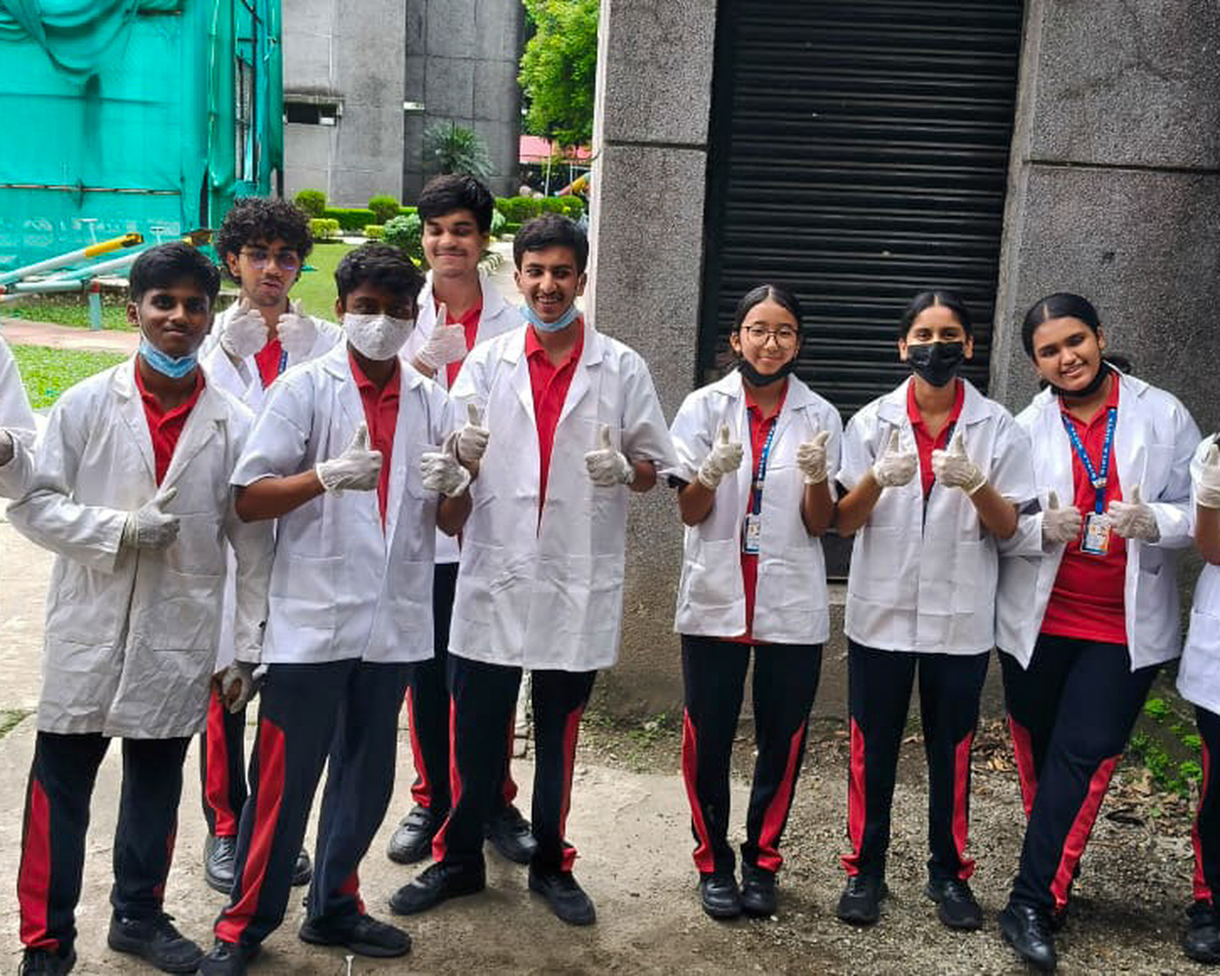


SDG 12 × SDG 14
TRASH TALK
Waste Segregation • Plastic Reduction • Smart Bins
A 12-week, student-led movement to sort smarter, ditch single-use plastic, protect life below water — and give our bins a brain.
BIRLA DIVYA JYOTI, SILIGURI
National Education Board — Vocational Training Project
The Trash Talk squad — suited up and ready for a cleaner BDJ
Reduce • Reuse • Re-educate • Report
BIRLA DIVYA JYOTI

Slide 2




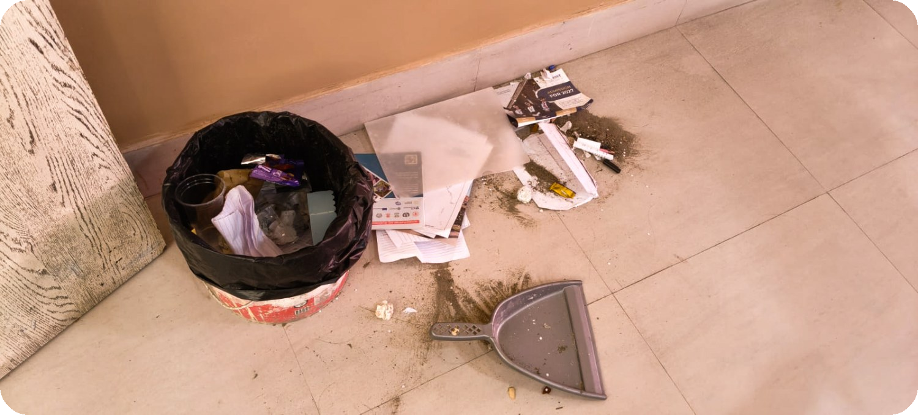
REALITY CHECK
Why our bins are the front line of the plastic crisis
11M+ tonnes
500 years
1 mixed bin
of plastic flow into the ocean every single year — choking the marine life SDG 14 protects.
for one plastic bottle to break down. Every wrapper we throw today outlives all of us.
was our starting point at BDJ — food, paper and plastic dumped together, value lost forever.
Exhibit A — our own corridor bin. No segregation, wet + dry mixed, recyclables ruined. This is exactly what the next 12 weeks fix.
BIRLA DIVYA JYOTI

Slide 3






THE MISSION
Turn one school's waste habit into a whole community's superpower
SDG 12 — RESPONSIBLE CONSUMPTION & PRODUCTION
Audit what we throw away, cut single-use plastics, and build a colour-coded segregation system that sticks.
WHAT WINNING LOOKS LIKE
A sustainable school waste plan
Student-led awareness campaigns
A working IoT smart bin prototype
A measurable drop in plastic — proven with our own data
SDG 14 — LIFE BELOW WATER
Research how plastic pollution hits oceans and rivers — then stop it at the bin, long before it reaches the Mahananda.
Educate every student → install the system school-wide → prove the reduction with data.
Audit
Campaign
Smart Bin
Impact
BIRLA DIVYA JYOTI

Slide 4


THE 12-WEEK GAME PLAN
Four phases, one glow-up: from mixed bins to a school that sorts on autopilot
WK 1–3
WK 4–6
WK 7–9
WK 10–12
LEARN & AUDIT
BUILD THE SYSTEM
CAMPAIGN & CREATE
COMMUNITY & PROOF
Launch SDG 12 & 14, form teams, run the waste audit + habit survey, research plastic's ocean impact.
Design the 3-bin setup, install the smart bin sensor, train monitoring squads, go live daily.
No Single-Use Plastic Week, NGO expert session, upcycling workshop — eco-bricks, art & planters.
Neighbourhood drive, re-audit vs baseline, present outcomes + next-year sustainability plan.
Every phase ships a deliverable: audit report → system plan → campaign docs → final report & recommendations.
BIRLA DIVYA JYOTI

Slide 5




STEP 1 — MAKING OF THE AUDIT
You can't manage what you don't measure — one week, every bin, weighed & logged
OBJECTIVES
Measure quantity & type of waste generated over one week
Analyse segregation efficiency — sorted vs mixed
Identify plastic usage patterns & hotspots
BIODEGRADABLE
RECYCLABLE
NON-RECYCLABLE
Food waste • fruit peels • paper • cloth • pencil shavings
Plastic bottles • glass • cans • clean cardboard
Multilayer plastic • chips packets • juice cartons • thermocol
→ headed for compost, not landfill
→ sorted clean so it actually gets recycled
→ the stuff we work to design out
Every category gets its own weighing log — the Week-2 numbers become our baseline for the whole project.
BIRLA DIVYA JYOTI

Slide 6




OUR WEEK-2 AUDIT DATA — BDJ SILIGURI
Raw weekly data collection (sample week) • all weights in kilograms
Day | Biodegradable (kg) | Recyclable (kg) | Non-Recyclable (kg) | Total (kg)
Monday | 12.4 | 4.2 | 3.1 | 19.7
Tuesday | 11.8 | 3.9 | 2.8 | 18.5
Wednesday | 13.1 | 4.5 | 3.4 | 21.0
Thursday | 12.0 | 4.0 | 3.0 | 19.0
Friday | 14.6 | 5.2 | 4.1 | 23.9
Saturday | 9.2 | 3.1 | 2.2 | 14.5
Sunday (hostel/office) | 3.5 | 1.2 | 0.9 | 5.6
WEEK TOTAL | 76.6 | 26.1 | 19.5 | 122.2
9 collection points
Classrooms, canteen, staff room, corridors & office bins — all weighed daily at 3 PM.
Audit squad of 12
Students in gloves + aprons sorted and logged every category by hand.
Verified twice
Each weight cross-checked by a second team member before entering the log.
Sample data recorded by the BDJ audit squad, Week 2 • Sunday covers hostel & office waste only
BIRLA DIVYA JYOTI

Slide 7

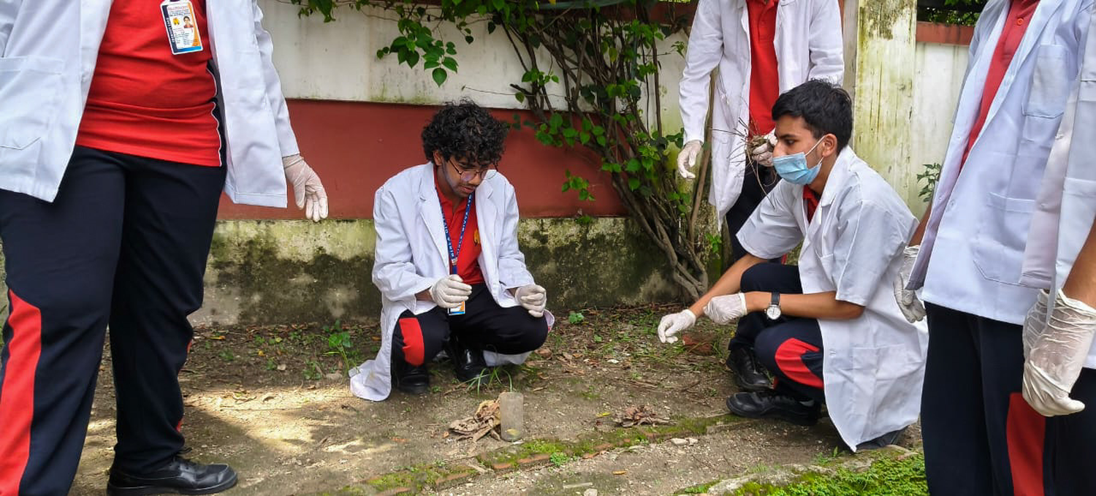
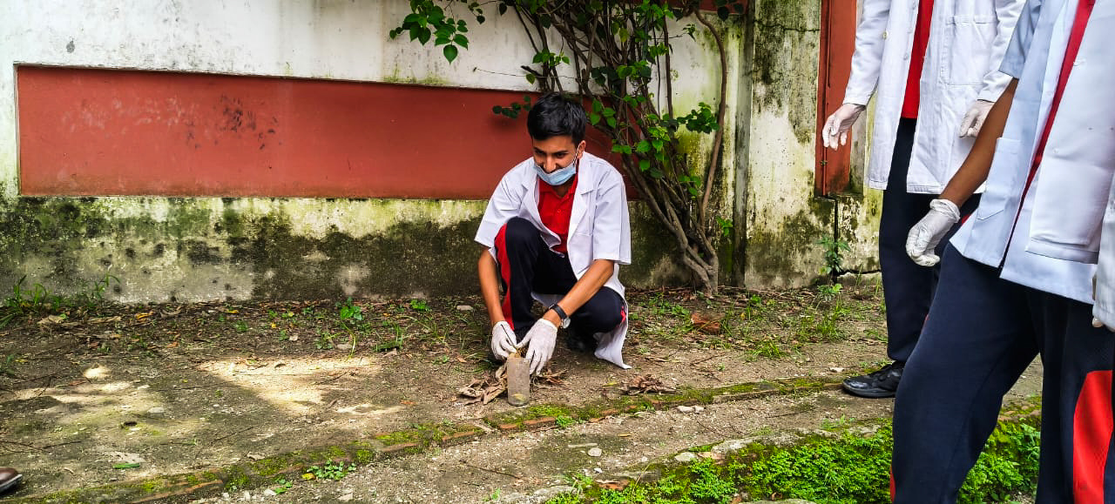
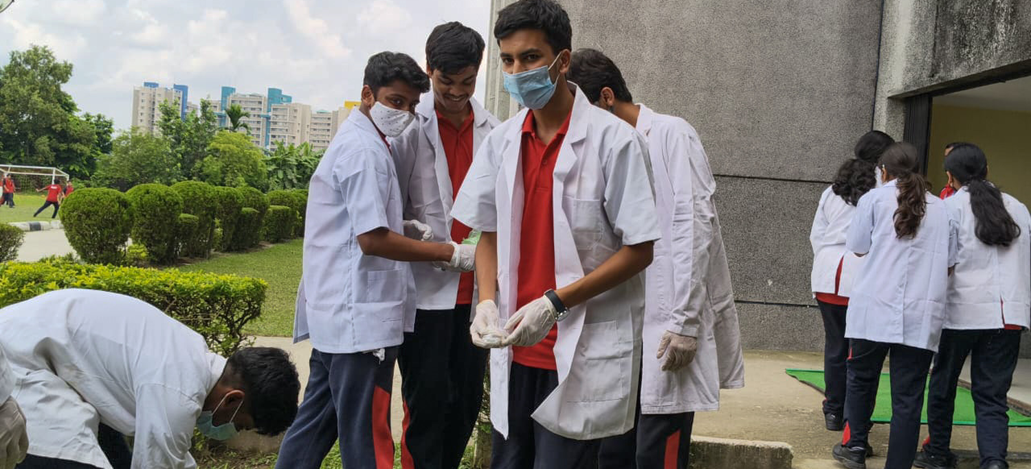
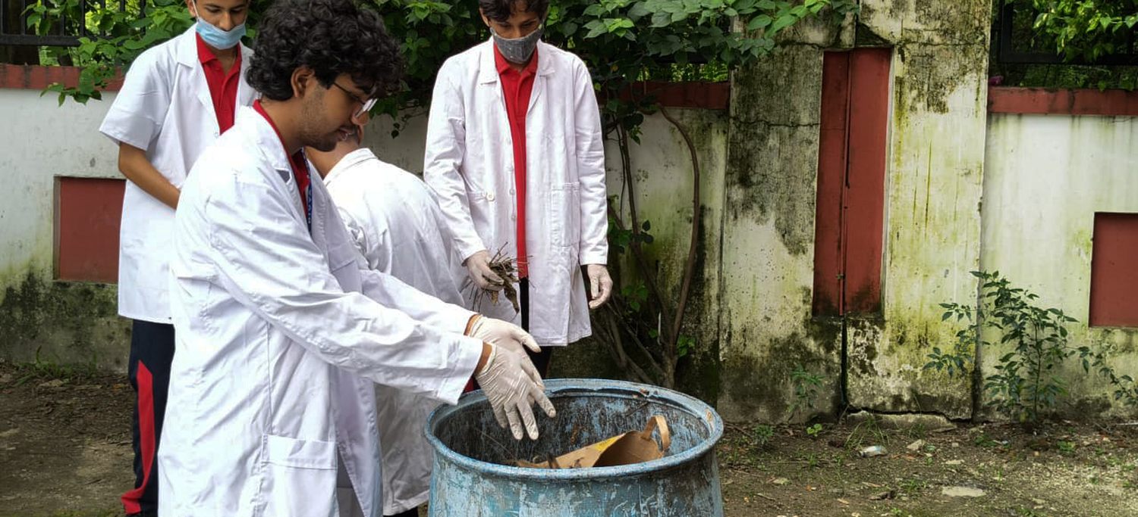
THE AUDIT SQUAD — IN ACTION
Gloves on, logs out — the Week-2 waste audit as it actually happened on campus
THE RULE
“Weigh it. Log it. Verify it.”
12 students, 9 collection points — every category weighed daily at 3 PM.
Each entry cross-checked by a second squad member before it enters the log.
Spotting & logging every waste hotspot
No corner of campus left unchecked
Gloved up — the squad heads out
Every find sorted straight into the drum
BIRLA DIVYA JYOTI

Slide 8
VISUAL WASTE REPRESENTATION
The same week of data, now in pictures — composition and daily flow
Nearly 2/3 of our waste can be composted on campus — it never needs a landfill.
Friday spikes every week — canteen special + activity day = extra wrappers.
BIRLA DIVYA JYOTI

Slide 9


WHAT THE NUMBERS TELL US
Audit analysis — totals, segregation efficiency, plastic patterns & the peak day
122.2 kg
62% / 38%
TOTAL WEEKLY WASTE
≈ 17.5 kg generated per day across campus
SEGREGATED vs MIXED
Only 62% reached the right bin — 38% still mixed
14.8 kg
FRIDAY
TOTAL PLASTIC WASTE
68% of it single-use: bottles, wrappers, straws
PEAK WASTE DAY — 23.9 kg
Canteen special + weekly activity day packaging
MOST COMMON PLASTIC ITEMS: water bottles • chips & biscuit wrappers • straws • polybags • pen refills
BIRLA DIVYA JYOTI

Slide 10


CHEMISTRY — KNOW YOUR POLYMER
Chemistry integration: what our bins taught us about PET, PE and PVC
PET
PE
PVC
Polyethylene Terephthalate
Polyethylene (HDPE / LDPE)
Polyvinyl Chloride
RECYCLABLE ✓
RECYCLABLE ✓
AVOID ✗
Water & soft-drink bottles. High recycling value if clean & dry. Code ♳1.
Milk pouches, polybags, bottle caps. Recyclable but rarely collected. Codes ♴2 / ♶4.
Pipes, some wrappers & toys. Releases toxic chlorine gases (dioxins, HCl) if burnt — never burn plastic!
Density ~1.38 g/cm³ — SINKS in water
Density ~0.92–0.96 g/cm³ — FLOATS in water
Density ~1.4 g/cm³ — SINKS in water
LAB DEMO — THE FLOAT TEST: drop plastic pieces in water → PE floats, PET & PVC sink. A 2-minute density test that identifies the polymer — and tells us instantly which bin it belongs in.
BIRLA DIVYA JYOTI

Slide 11
SORT LIKE A PRO — THE 3-BIN SYSTEM
Colour-coded, student-monitored, zero excuses
GREEN BIN
BLUE BIN
RED BIN
BIODEGRADABLE
RECYCLABLE
NON-RECYCLABLE
Food scraps, fruit peels, leaves, soiled paper — composted in the school pit.
Clean paper, plastic bottles, cans, cardboard — collected by the recycler weekly.
Chips wrappers, multilayer packs, broken pens — minimised, then safely disposed.
MONITORING SQUADS check bins daily & post a class-wise leaderboard — best sorters win bragging rights.
BIRLA DIVYA JYOTI

Slide 12
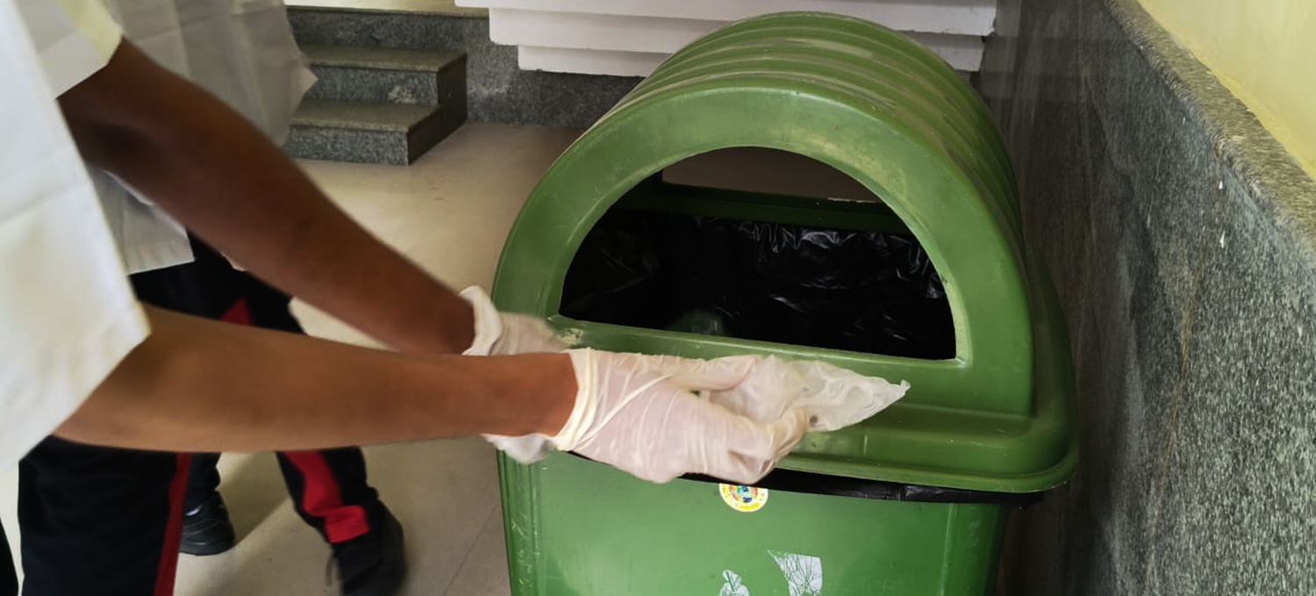
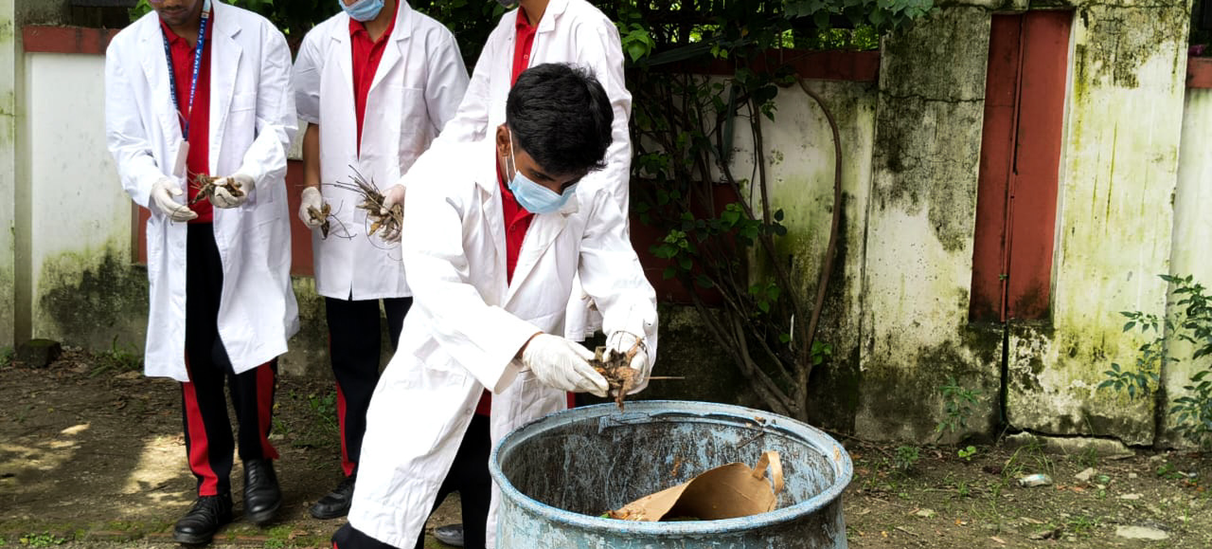
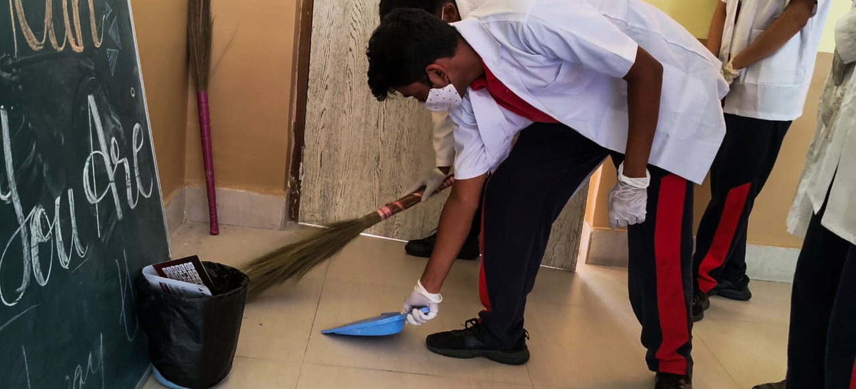
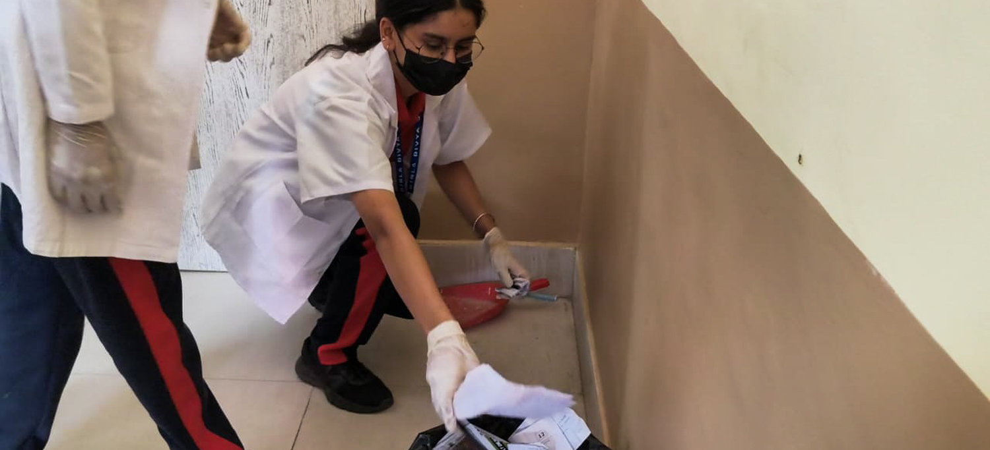
SEGREGATION DRIVE — IN ACTION
From corridor to compost drum — the 3-bin habit, practised by the people who built it
THE HABIT
“Sort at the source — not at the dump.”
Green, blue, red — colour first, throw second. The bins do the teaching.
Lab-coat crews model the habit until every class runs it on autopilot.
Right waste, right bin — every single time
Biodegradables head for the compost drum
Classrooms swept & sorted daily
Monitoring squads keep every wing clean
BIRLA DIVYA JYOTI

Slide 13
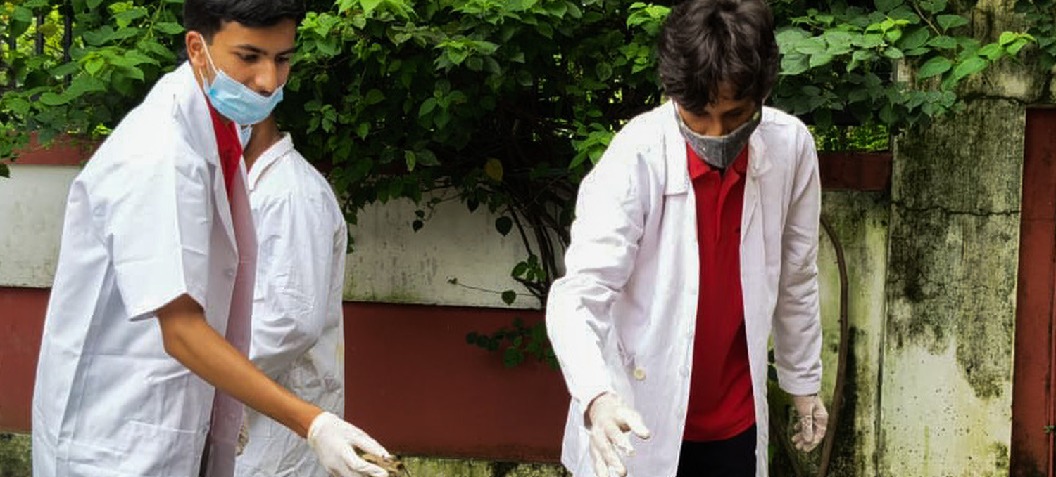
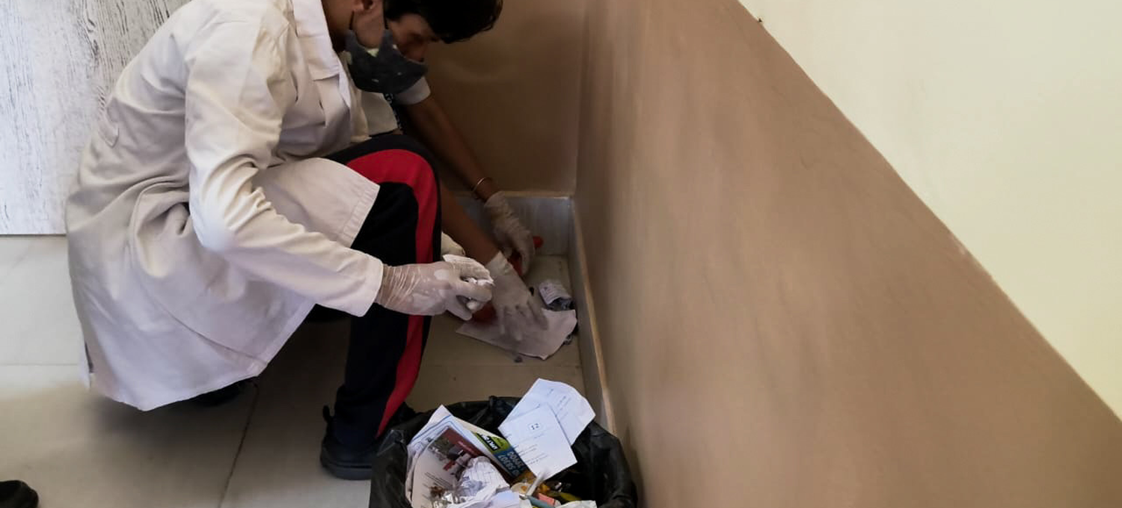
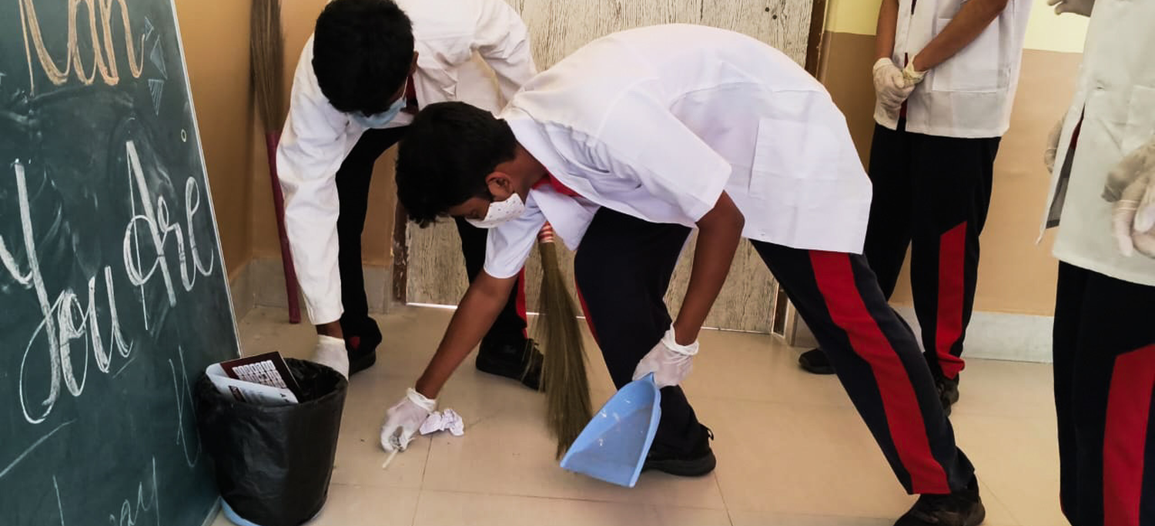
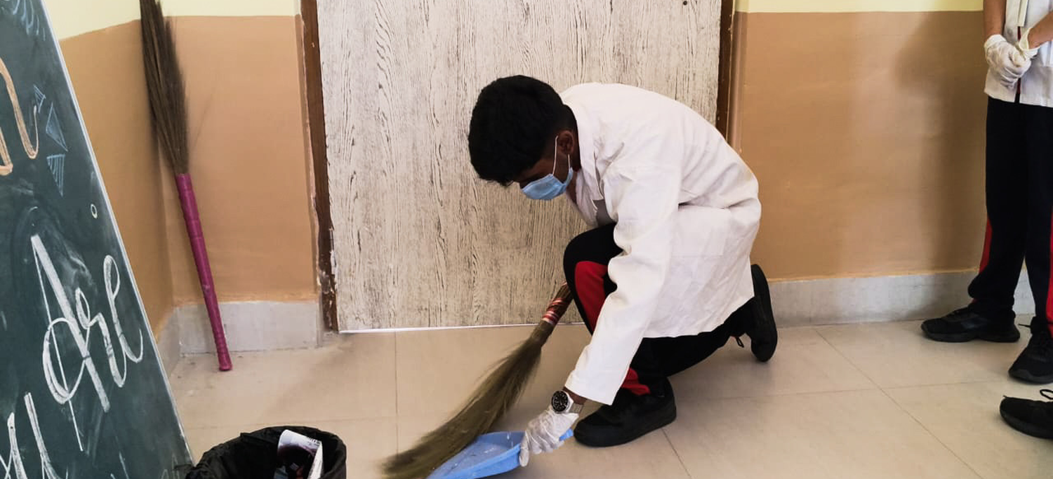
EVERY HAND ON DECK
More from the drive — sweeping, sorting and hauling until the whole campus runs the system
THE SPIRIT
“Nobody’s job — so it’s everybody’s job.”
Seniors and juniors rotate duty, so no wing is ever left out.
Every drive is photographed and logged as evidence for the final report.
Team drops — straight to the right drum
Hand-sorting recyclables from the pile
Sweep, scoop, sort — the daily routine
Kneeling down to catch every last scrap
BIRLA DIVYA JYOTI

Slide 14
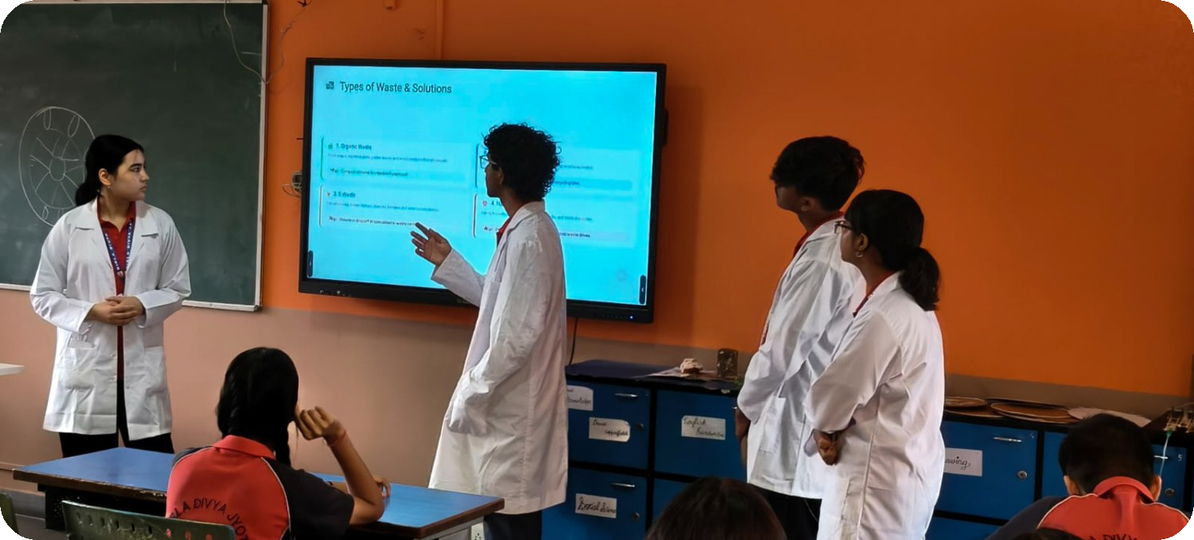
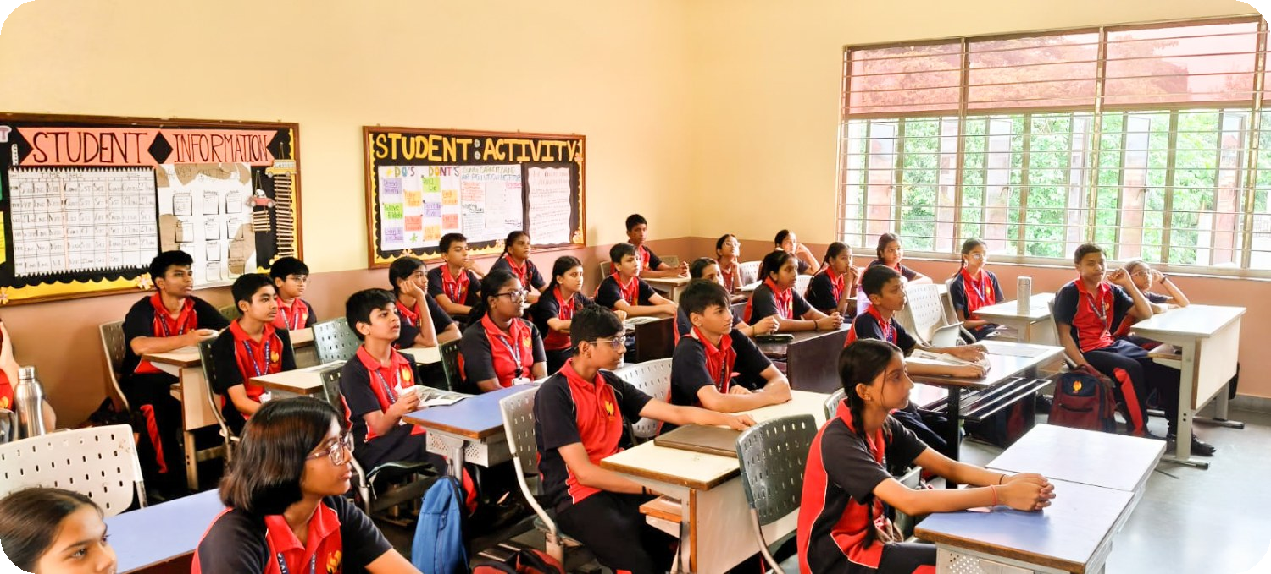
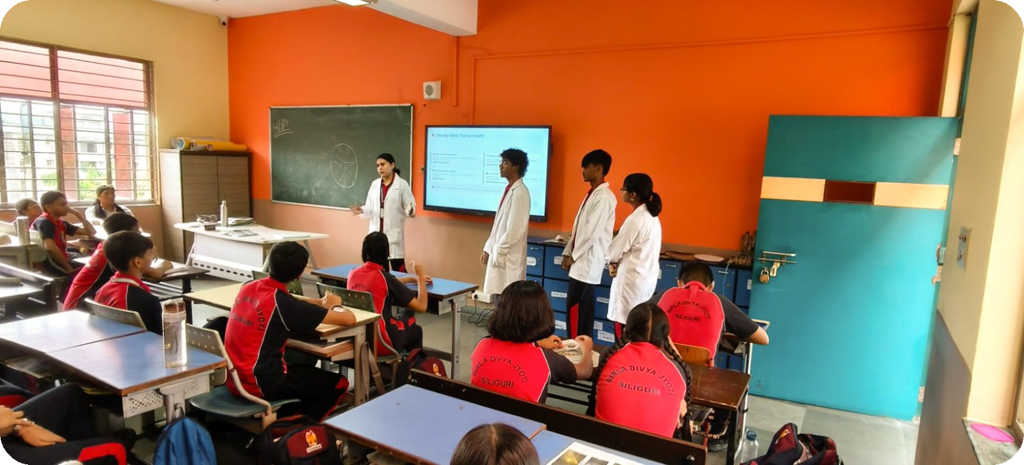
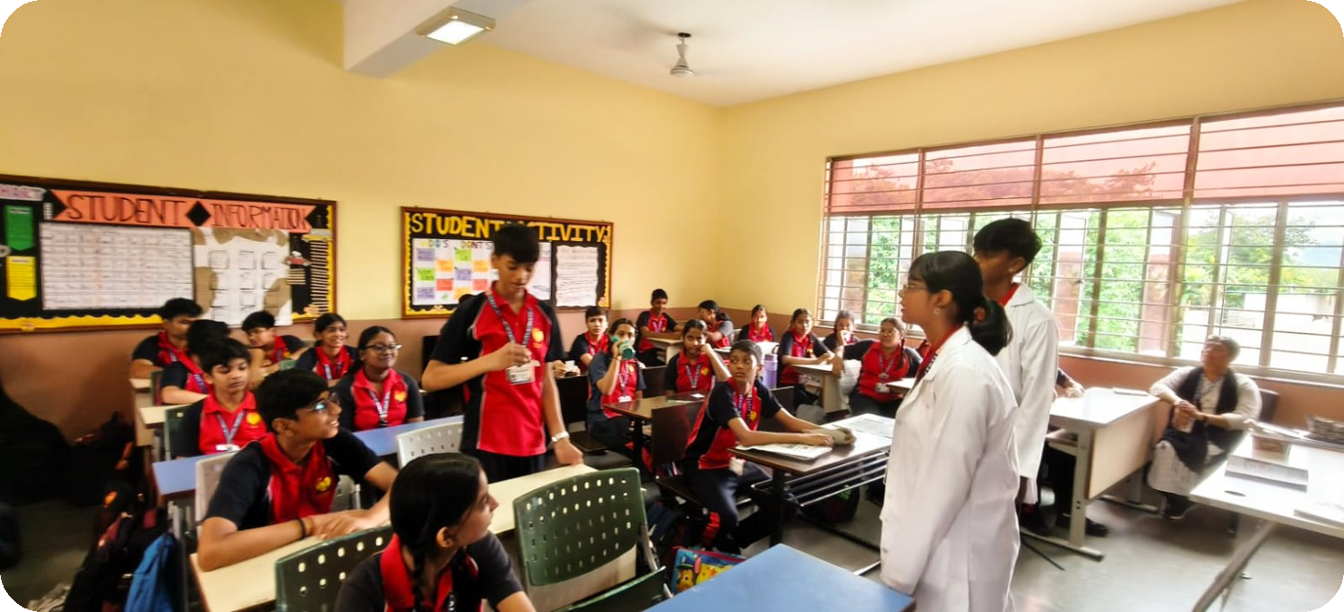
ON THE GROUND AT BDJ — EVERY WING
Every classroom, every wing: senior lab-coat crews took the message class to class
THE HOOK
“Convenience Today, Crisis Tomorrow!”
Every choice framed as a game — fast & easy vs thinking ahead.
Posters, live votes and demos in every room, senior and junior.
Smart-board sessions on waste types
Junior classes join the movement
Live demos wing by wing
Q&A — segregation becomes culture
BIRLA DIVYA JYOTI

Slide 15

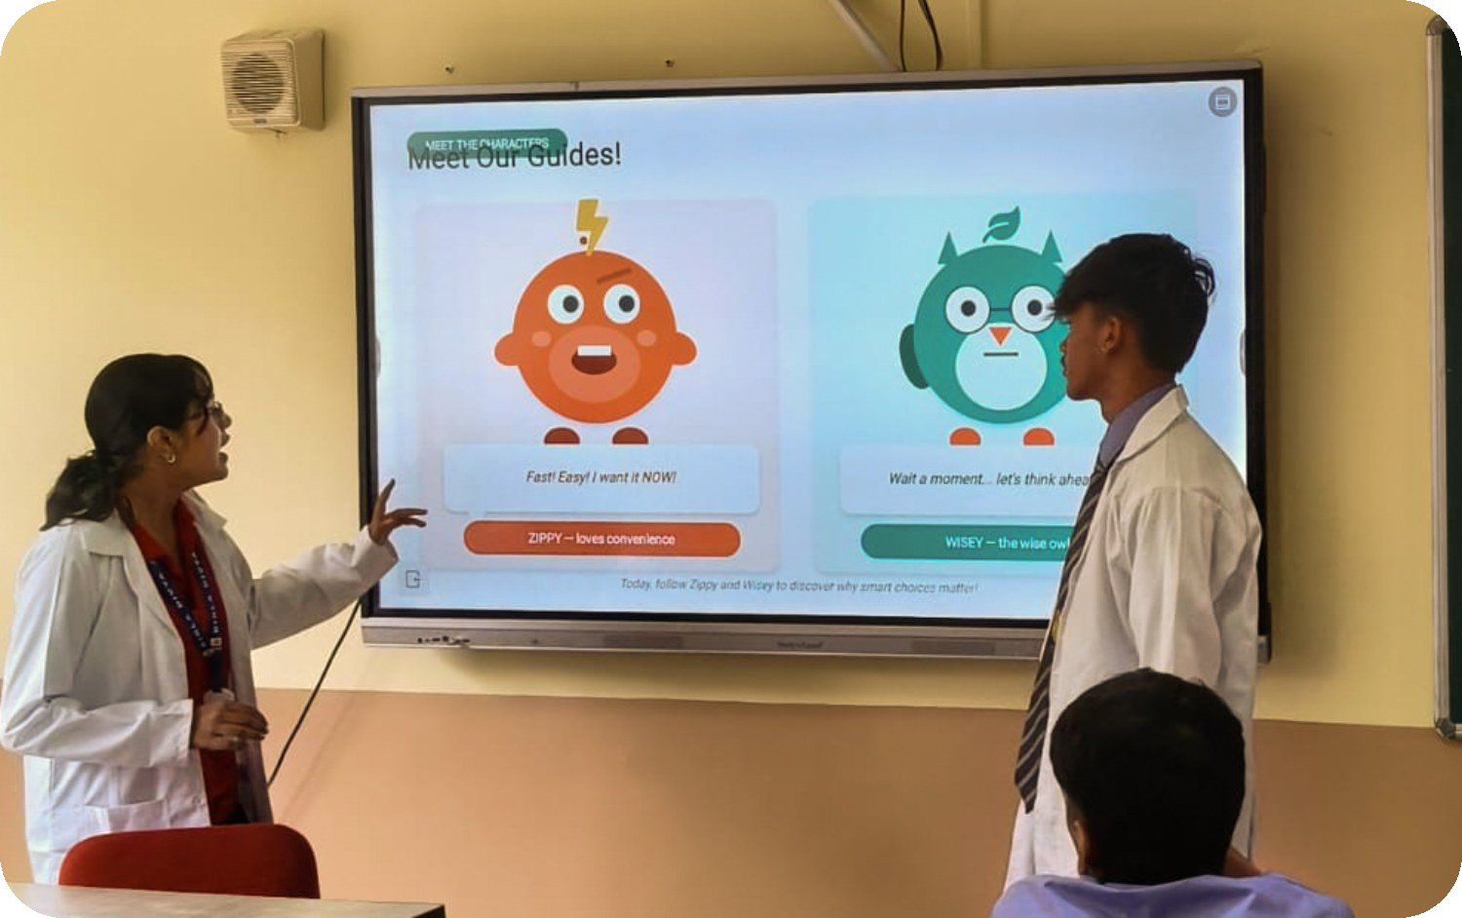
ZIPPY vs WISEY — STORYTELLING THAT STICKS
Gamified mascots that made segregation something kids retell at lunch
⚡ ZIPPY — “Fast! Easy! I want it NOW!”
The voice of convenience: single-use bottles, wrappers, zero thought. Every class knows a Zippy.
🦉 WISEY — “Wait… let's think ahead.”
The wise owl who sees the crisis tomorrow behind the convenience today — and chooses better.
🎮 WHY IT SLAPS
Peer pressure flipped into planet pressure: live votes at the start and end of class — the swing measures the mind-change.
Live on the smart board: classes vote Zippy-vs-Wisey in real time
Behaviour change lands when it's a story — not a rule on a wall.
BIRLA DIVYA JYOTI

Slide 16

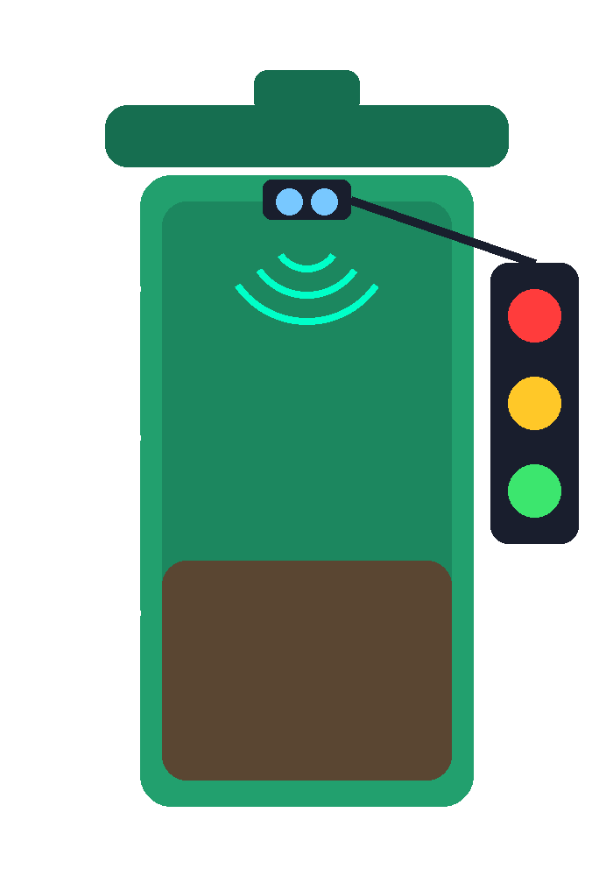

THE SMART BIN — OUR BIN GETS A BRAIN
One ultrasonic sensor + three LEDs = a bin that reports its own fill level
GREEN LED — bin has space
Fill level around 20% — all good, keep sorting.
YELLOW LED — bin getting full
Fill level around 60% — housekeeping gets a heads-up.
RED LED — bin full, collection required
Fill level 90%+ — instant alert, bin must be cleared.
LIVE DEMO SCRIPT: drop paper into the bin and watch Green → Yellow → Red light up as the level rises. “In a real implementation, when the bin reaches the critical level, this information is transmitted to the municipal monitoring system — and to our own school housekeeping team.”
1 × ultrasonic sensor (HC-SR04) under the lid measures distance to the waste surface
BIRLA DIVYA JYOTI

Slide 17
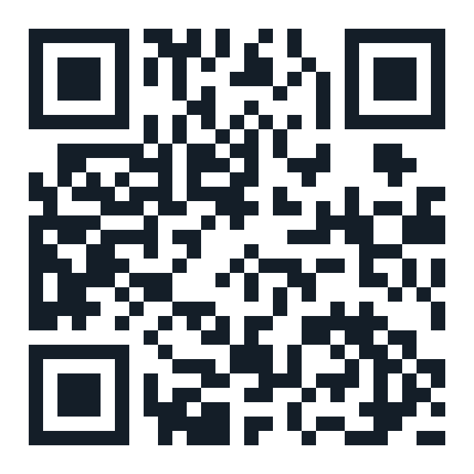






SCAN. REPORT. SORTED.
A QR code on every bin turns any student's phone into a waste-alert button
🚨 WASTE ALERT FORM
HOW THE DEMO WORKS
Location — Bin BDJ-017
1. SCAN the QR with any phone
Type — Overflowing waste
2. SUBMIT the pre-filled alert form
Priority — High
3. DATA lands in a Google Sheet — our live demo database
BIN ID: BDJ-017
Upload photograph
Canteen corridor, ground floor
(demo QR — opens our Google Form)
4. JUDGES watch the dashboard update in real time
Date & time — auto-filled
No municipality contact needed for the demo — the Sheet is the monitoring system.
BIRLA DIVYA JYOTI

Slide 18




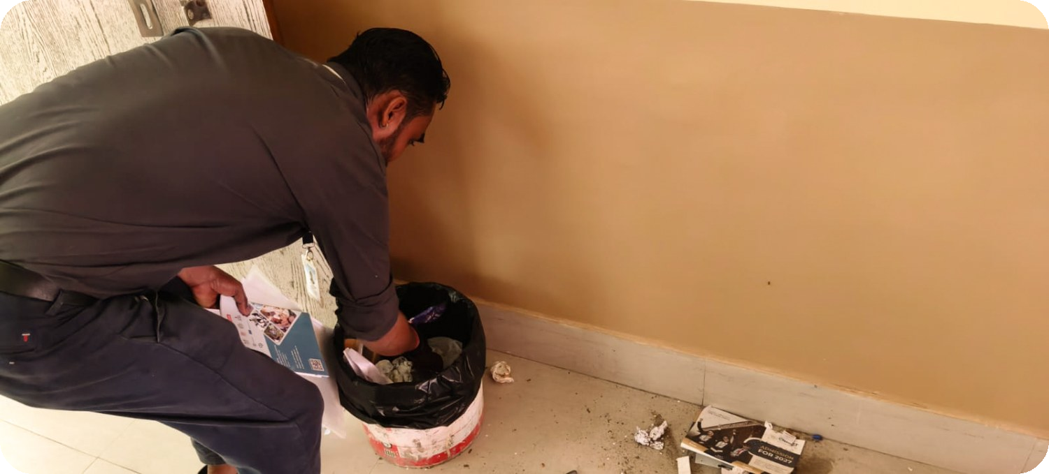
CLOSING THE LOOP — BDJ WORKERS RESPOND
The smart bin doesn't just blink — it tells the school housekeeping staff exactly where to go
TRIGGER
NOTIFY
ACTION
LOGGED
Bin hits 90% — RED LED on, or a student files a QR alert
Auto-alert to the housekeeping supervisor's phone: bin ID + location + priority
Nearest BDJ housekeeping staff member clears & relines the bin
Cleared time entered in the sheet — response time tracked per bin
PILOT ZONES & RESPONSE TEAM
Zone A — Junior wing & library: 2 smart bins • 1 staff member on call
Zone B — Canteen & corridors: 3 smart bins • 2 staff members (peak: lunch break)
Zone C — Senior wing & labs: 2 smart bins • 1 staff member on call
Target response time: under 15 minutes from RED alert to cleared bin
BDJ support staff — the real heroes of the loop
BIRLA DIVYA JYOTI

Slide 19
THE DEMO DASHBOARD — SAMPLE ALERT LOG
Every scan and sensor trigger becomes a row judges can watch appear live
Date / Time | Bin ID | Location | Fill % | Source | Assigned | Response
Mon 09:42 | BDJ-017 | Canteen corridor | 92% | Sensor (RED) | Zone B staff | 11 min
Mon 13:15 | BDJ-004 | Junior wing | 88% | QR report | Zone A staff | 9 min
Tue 10:05 | BDJ-011 | Senior labs | 63% | Sensor (YELLOW) | Watchlist | —
Tue 13:22 | BDJ-017 | Canteen corridor | 95% | Sensor (RED) | Zone B staff | 13 min
Wed 11:48 | BDJ-006 | Library entrance | 90% | QR report | Zone A staff | 14 min
Thu 12:57 | BDJ-017 | Canteen corridor | 91% | Sensor (RED) | Zone B staff | 8 min
Fri 13:31 | BDJ-009 | Activity hall | 94% | QR report | Zone C staff | 12 min
7 alerts
11.2 min
BDJ-017
0 overflows
logged in demo week
average response time
busiest bin — canteen
since smart bin go-live
BIRLA DIVYA JYOTI

Slide 20
SOLUTIONS — THE 3R PLAYBOOK
Reduce, Reuse, Recycle — plus compost, campaigns and smarter bins
Plastic bottle
Steel bottle
Polybag
Cloth bag
Cling-wrapped snacks
Steel lunchbox
Straws & cutlery
Skip it / reusable
Plus: compost pits for biodegradable waste • awareness posters • refill stations across campus
Waste ↓ • recycling ↑ • plastic ↓ — proven by the Week-11 re-audit.
IMPACT WE TARGET AFTER IMPLEMENTATION: total waste ↓ 25% • recycling rate ↑ 40% • single-use plastic ↓ 60%
BIRLA DIVYA JYOTI

Slide 21
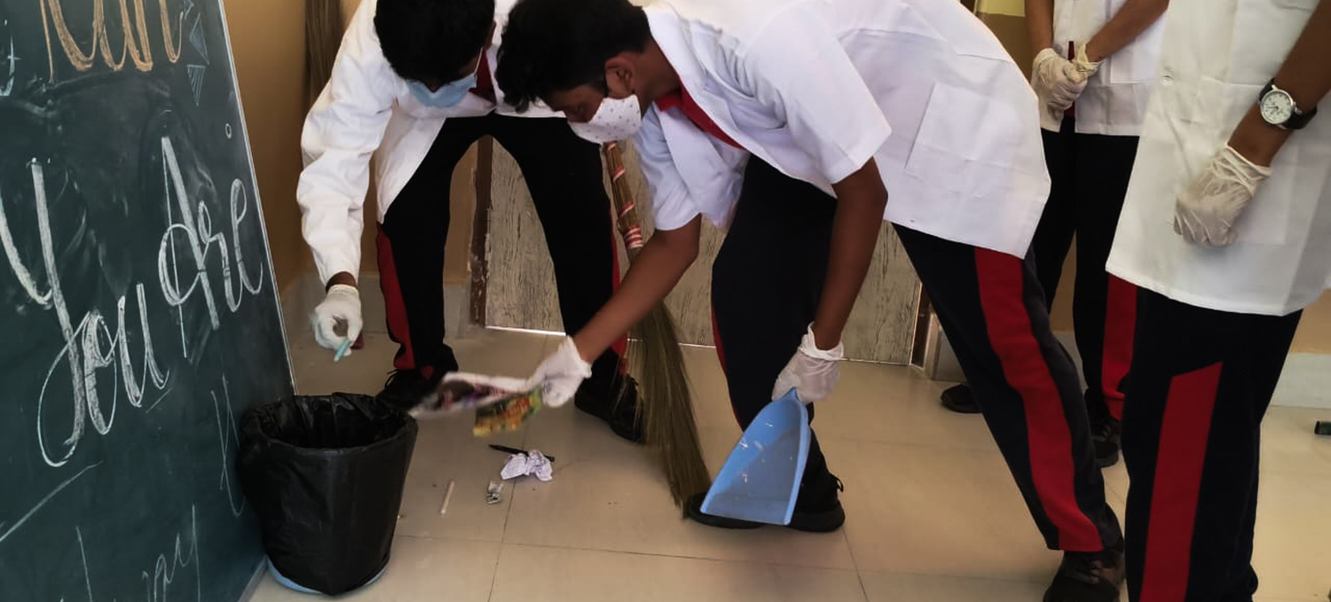
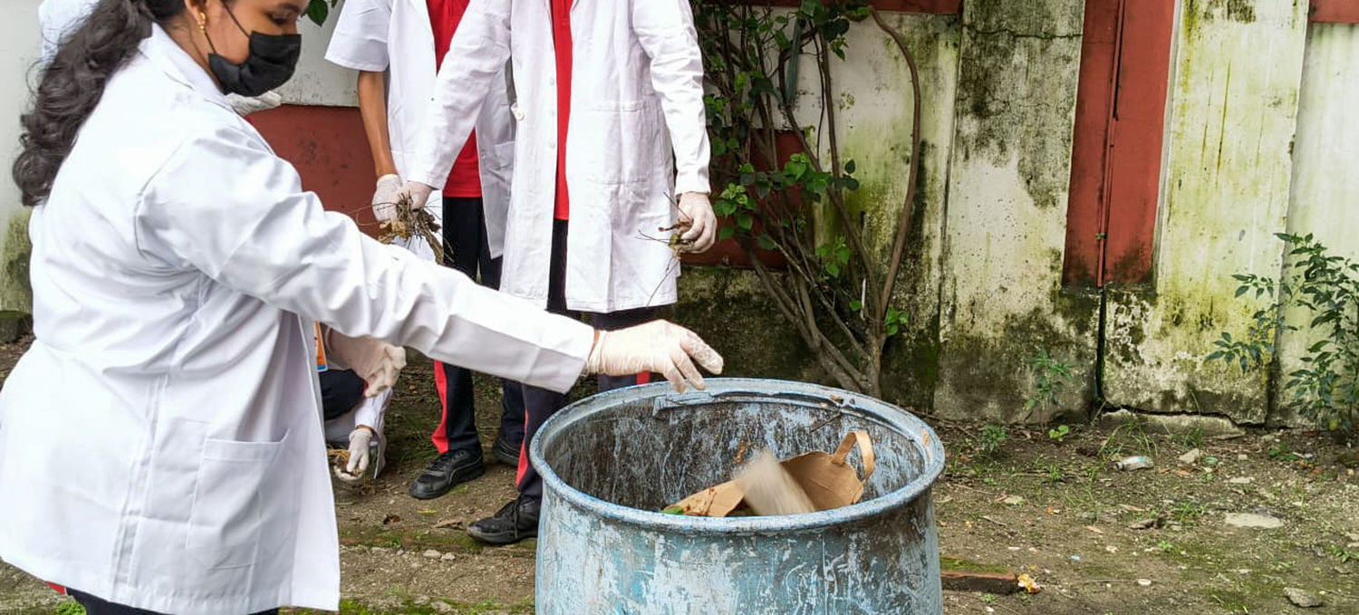
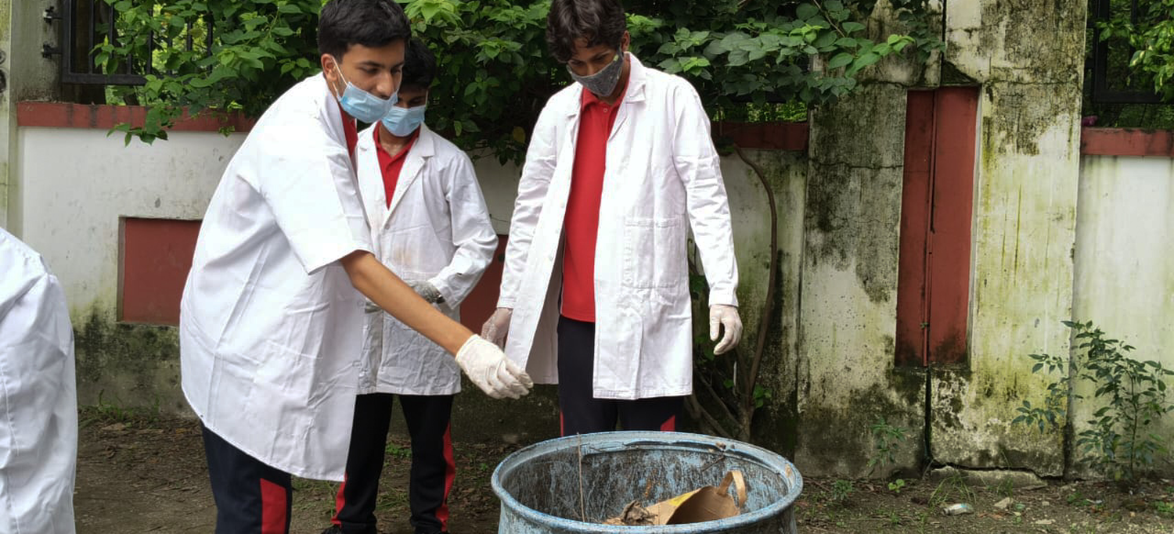
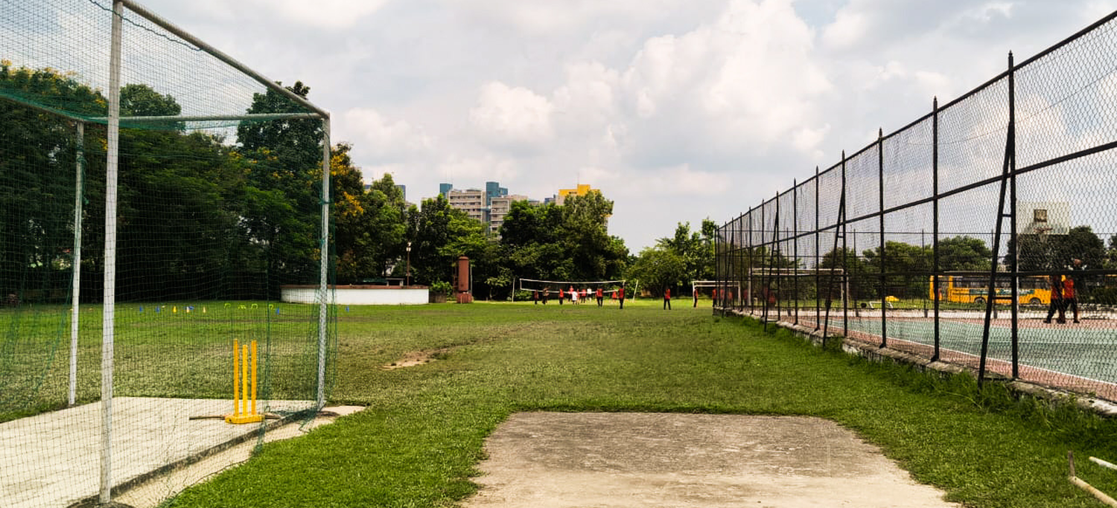
THE CAMPUS WE’RE CLEANING FOR
Team effort today, cleaner grounds tomorrow — the system works beyond the classroom
THE PAYOFF
“Small sorts, big shifts.”
Every photo here is student-run — no outsourcing, no shortcuts.
Next stop: the neighbourhood clean-up drive in Weeks 10–12.
Teamwork on every corridor
Everyone throws — the sorted way
Final checks before the compost run
The prize — a clean, green BDJ campus
BIRLA DIVYA JYOTI

Slide 22


SMALL SORTS, BIG SHIFTS
Weekly audits make our decisions data-driven • smart bins make the system self-reporting • students make it a culture
DATA-DRIVEN
TECH-ENABLED
PEOPLE-POWERED
SDG-ALIGNED
The weekly audit turns habits into numbers — and numbers into decisions.
One sensor, three LEDs and a QR code keep every bin honest, 24/7.
Students report, BDJ housekeeping responds — a full loop inside our school.
Responsible consumption (SDG 12) protecting life below water (SDG 14).
BE A WISEY. SORT TODAY. 🌊
THANK YOU • Waste Segregation & Plastic Reduction • SDG 12 & 14 • Birla Divya Jyoti, Siliguri
BIRLA DIVYA JYOTI

